Slide 1
Presenter notes
Resources:
Docs: Managing your work on GitHub
Docs: About Issues
Ben Balter blog: Types of pull requests
Guide: Mastering Markdown
Cheatsheet: Markdown
Docs: Markdown advanced formatting
Example: Discussions
Docs: Managing labels
Example: Labels
Docs: Creating a default label
Docs: About milestones
GitHub Marketplace
Docs: About Project Boards
Example: Org with many projects
Docs: Finding information in a repository
Docs: About notifications
Docs: About issue and pull request templates
Docs: Templates for project boards
Docs: Sharing workflow templates within your organization
Ben Balter blog: Habits of highly effective GitHubbers
Ben Balter blog: Rules for communicating at GitHub
Guide: GitHub Flow
Hubot
Demo prep:
See 02_issues-and-projects-walkthrough-and-CLI.docx
FAQ:
On several slides, between sections
Customer stories:
-
Expected timing:

Slide 2
Issues & project management
GitHub Bootcamp
@presenter name (optional)

Slide 3
This module will enable you to
Understand the functionality, application and benefit of issues in the DevOps workflow
Implement best practices for project management on GitHub

Slide 4
Working on GitHub
Managing work with issues
Labeling issues and pull requests
Tracking progress with milestones
Managing and tracking progress with project boards
Finding information in a repository
Notifications
Templates
How GitHub uses GitHub
Notes:
Today we will have examples and show the UI
You probably know what issues and projects are as features, but we’ll go into how they are used to collaborate on GitHub.
********
Resources
https://docs.github.com/en/github/managing-your-work-on-github
********

Slide 5
Work management with issues

Slide 6
Issues
Use issues to track ideas, enhancements, tasks, or bugs for work on GitHub.
Notes:
Issues can be thought of as work items
First, quick description on GitHub URL format https://github.com/OWNER/REPO/thing (issues, pull, wiki, project, settings, settings/access, ...)
********
Resources
https://docs.github.com/en/github/managing-your-work-on-github/about-issues
********

Slide 7
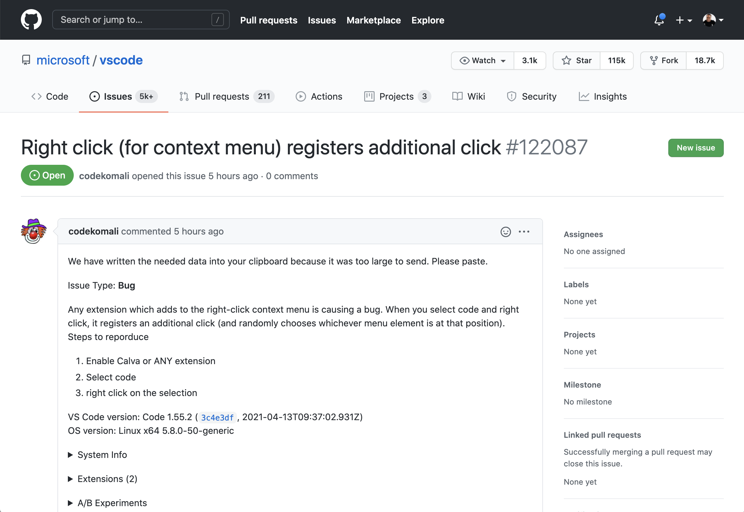
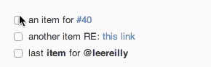
An issue
Notes:
Issues are similar to Pull Requests in the backend database. But pull requests are different because they include features such as code checks and deployment functionality.
The way that issues and pull requests are used also differs:
An issue is the element that members use to propose ideas or solutions to specific problems.
Note that issues can be assigned to multiple users at once. This means that all of those participants will be notified of any changes or comments to the issue.
Track tasks directly inside of issues. See https://github.blog/2013-01-09-task-lists-in-gfm-issues-pulls-comments

Slide 8
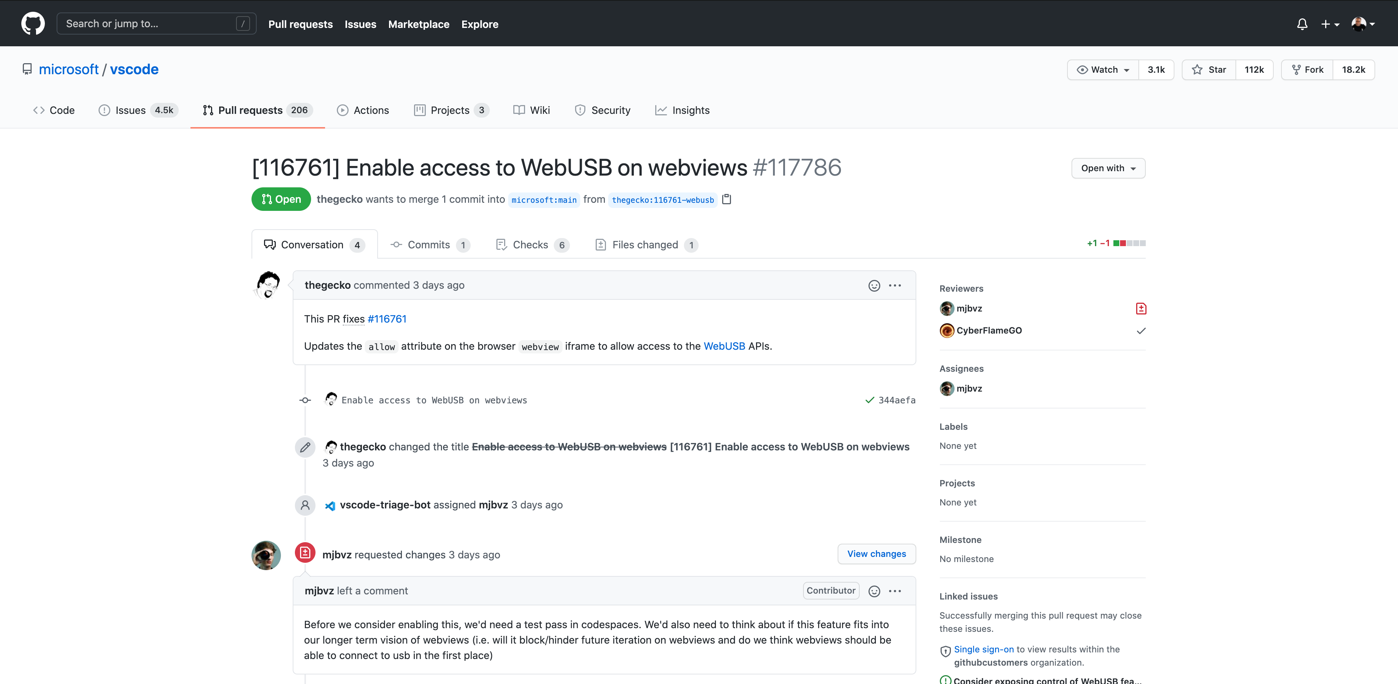
A pull request
Notes:
Note for speaker: Where does the phrase “pull request come from?” The idea is that a member makes a change to a project in their own branch. Subsequently, the member submits their work and requests that these changes be integrated or “pulled into” the main code base.
********************
A pull request is opened by that member to submit the actual code or project change that is the solution to the idea already discussed.
********************
Resources
https://ben.balter.com/2015/12/08/types-of-pull-requests as an additional resource for the presenter when discussing pull requests
********************

Slide 9
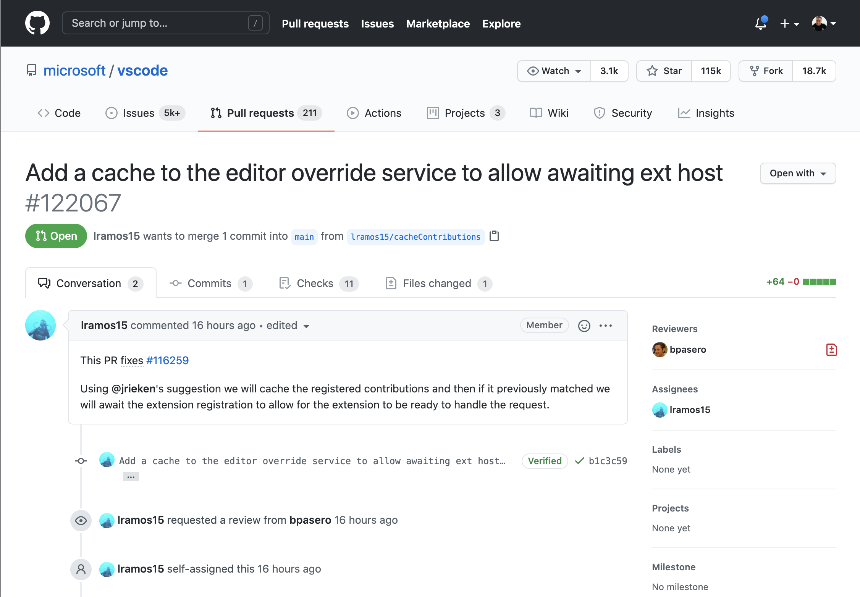
A pull request
Notes:
Note for speaker: Where does the phrase “pull request come from?” The idea is that a member makes a change to a project in their own branch. Subsequently, the member submits their work and requests that these changes be integrated or “pulled into” the main code base.
********************
A pull request is opened by that member to submit the actual code or project change that is the solution to the idea already discussed.
********************
Resources
https://ben.balter.com/2015/12/08/types-of-pull-requests as an additional resource for the presenter when discussing pull requests
********************

Slide 10
The timeline
Notes:
The timeline
One feature of the GitHub interface is the timeline.
The timeline shows
activity that has happened in issues and pull requests including comments and assignments
users that initiated the activity
when the action took place
Icons in the timeline indicate the type of action taken. Issue and pull request comment syntax follows GitHub-flavored markdown
********
Resources
https://guides.github.com/features/mastering-markdown/
********

Slide 11
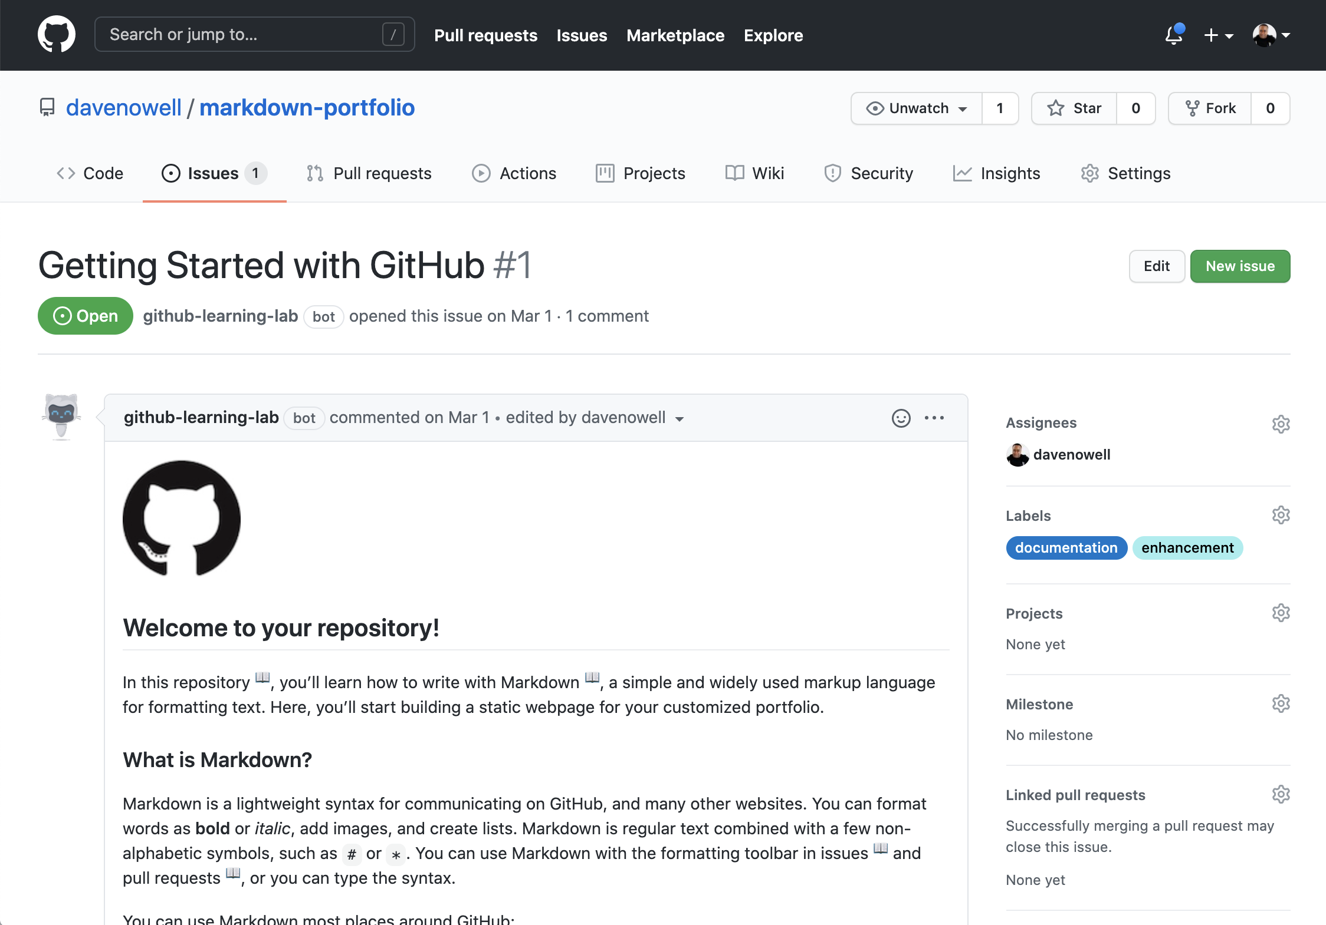
Markdown capabilities
Notes:
Issues and pull requests are written in markdown and support rich capabilities:
@mention and team mention
Auto-close
Cross-referencing issues using the # followed by the issue number.
Autolink refs
Code, tables, italics, bold… formatting
Images and videos can be embedded directly into markdown
Post a like for an issue
******************
Resources
Learn more about GitHub-flavored markdown syntax at this URL: https://guides.github.com/features/mastering-markdown
Some additional resources to include: https://guides.github.com/pdfs/markdown-cheatsheet-online.pdf
https://docs.github.com/en/github/writing-on-github/working-with-advanced-formatting
******************

Slide 12
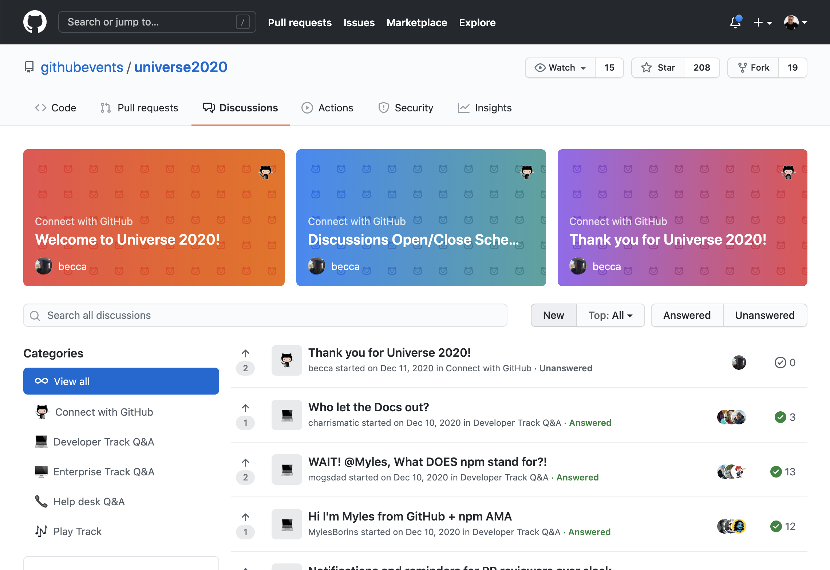
Issues vs. Discussions
Notes:
Issues vs. Discussions
An issue is the element used to present a concrete project-related problem needing a solution. The issue details the suggested solution to that problem and/or gathers thoughts, ideas and specific information related to it. An issue can also be closed by a pull request once the problem or bug has been resolved. For example, a project that contains code to build an open source text editor may have an issue entitled “Add support for Spanish language spell-checking.” The issue may contain comments from the support team that has submitted a feature request from a customer for the specific functionality. A response may be posted by the development team with a note that indicates that development is underway.
In contrast, a discussion does not exist with the purpose of solving any project-related challenge. Instead, a discussion may center around topics or conversation related to the project. For example, the same project mentioned above may have a discussion that compares and contrasts the best matching dependencies to use in the code base.
Discussions are only available for limited audiences at this time - they are a new feature, primarily developed for Open Source communities. Organizations may not have access to discussions on their enterprise subscriptions
******************
Resources
https://github.com/githubevents/universe2020/discussions
Discussions in the wild: https://github.com/microsoft/winget-pkgs
********************

Slide 13
Questions
Notes:
********************
Note to presenter:
The questions below are for your reference only. They are ones that you can anticipate receiving from the audience. However, there is no need to pose these to your audience.
********************
Q: Can you assign multiple people to an issue or PR?
A: Yes, up to 10.
Q: What is markdown?
A: Markdown is a lightweight and easy-to-use syntax for styling all forms of writing on the GitHub platform. Markdown allows you to format and organize your issues and PRs in a way that is more easily read. The capabilities inside of issues and pull requests simplify work between teams and individuals.
@mention capability - Enables collaboration between individuals and teams within issues and pull requests. Example: @janedoe or @devteam1
Reference to issue - Use # and the number of an issue inside of a PR to automatically close the issue that the PR relates to. Example: This PR closes issue #4. The keyword “closes” is recognized by the system and closes the related issue. You can reference issues from inside of another Issues in a similar way. For example, place a comment inside of an issue “Please refer to related issue #10”
Code blocks - Place code block directly inside of your issue comments. The code is formatted in UTF-8 which makes it easier to copy.
Markdown - Enables the use of tables, italics, bold and other common formatting for text.
Q: How do discussions and wikis relate? How persistent are they? Can they be moved to a wiki for retention? Are they searchable/taggable? Can they be locked?
A: They don't relate from an interconnectivity perspective. You could have a discussion inside of a discussion. Decide if it should live long term, and move it to a wiki. We don't often recommend wikis. We recommend people create GitHub Pages sites instead of using a wiki.

Slide 14
Labels for issues and pull requests

Slide 15
Labels
Labels help organize:
Issue types
Owners
Issue status
Priority
Notes:
Labels on GitHub help you organize and prioritize your work. You can apply labels to issues and pull requests to signify priority, category, or any other information you find useful.
Organization
Labels are how we start to divide up and contextualize aspects such as:
the type of issue (example: a bug or a feature request)
the owner
the status (such as "in progress" or "under review")
Priority
Labels are a great way to also instill traceability concepts.
******************
Note to presenter:
The API can also be used to take advantage of the labelling system.
******************
Resources
https://docs.github.com/en/github/managing-your-work-on-github/managing-labels
Share as example: https://github.com/microsoft/vscode/labels

Slide 16
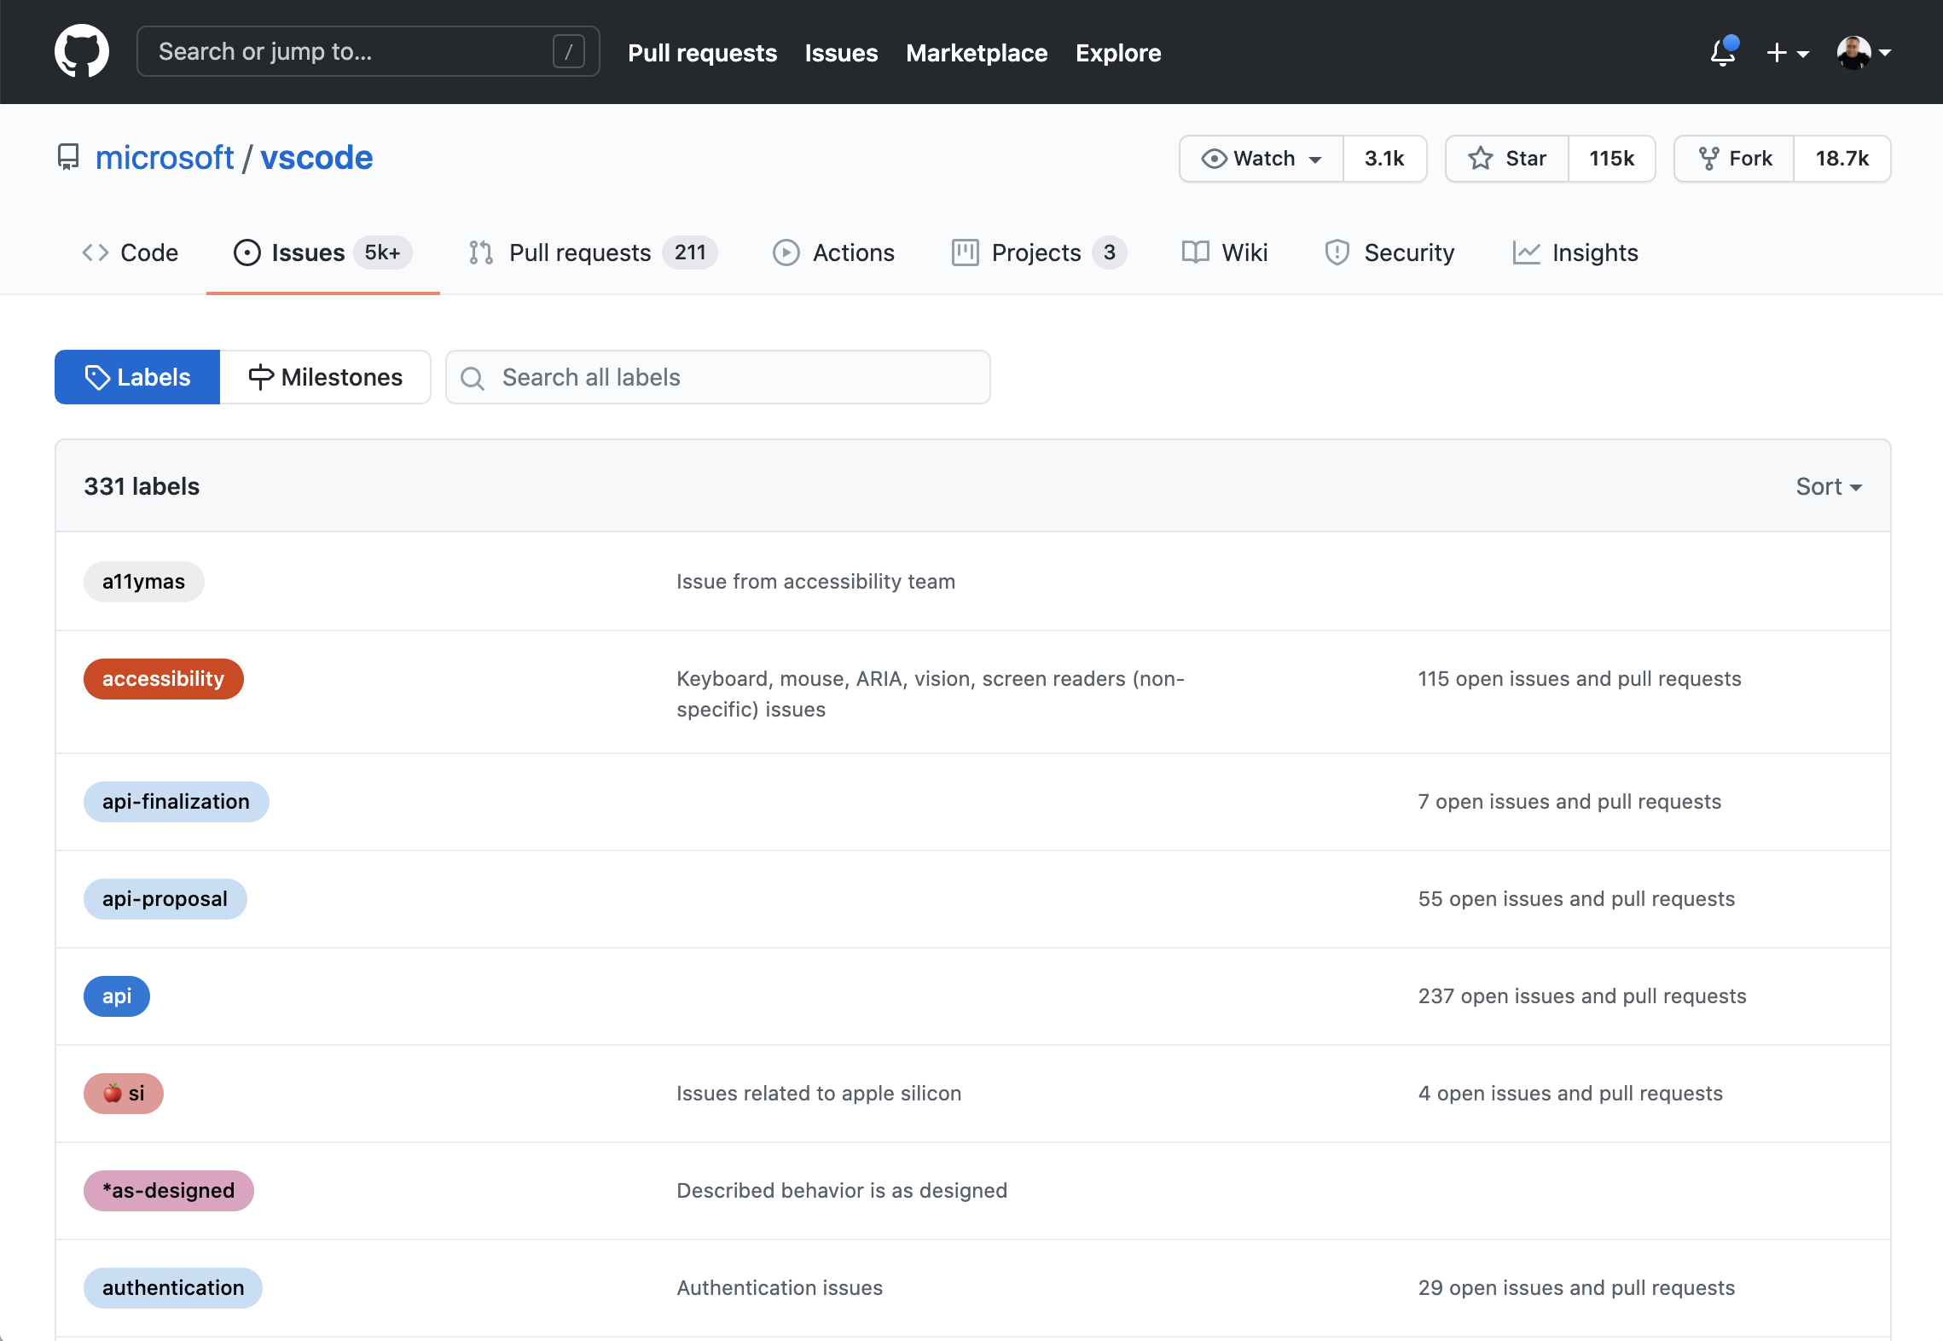
Label definition
Notes:
Label types and definition
The URL format to navigate directly to the label management interface of your repository is formatted like this:
https://<domainname>/<username>/<repository>/labels
Define labels in a repository at `/labels`
You can also add emojis ⚠️ 🐛 🏡 to labels
********************
Resources
https://github.com/microsoft/vscode/labels
Further documentation on labels can be found here: https://docs.github.com/en/github/setting-up-and-managing-organizations-and-teams/managing-default-labels-for-repositories-in-your-organization#creating-a-default-label
********************

Slide 17
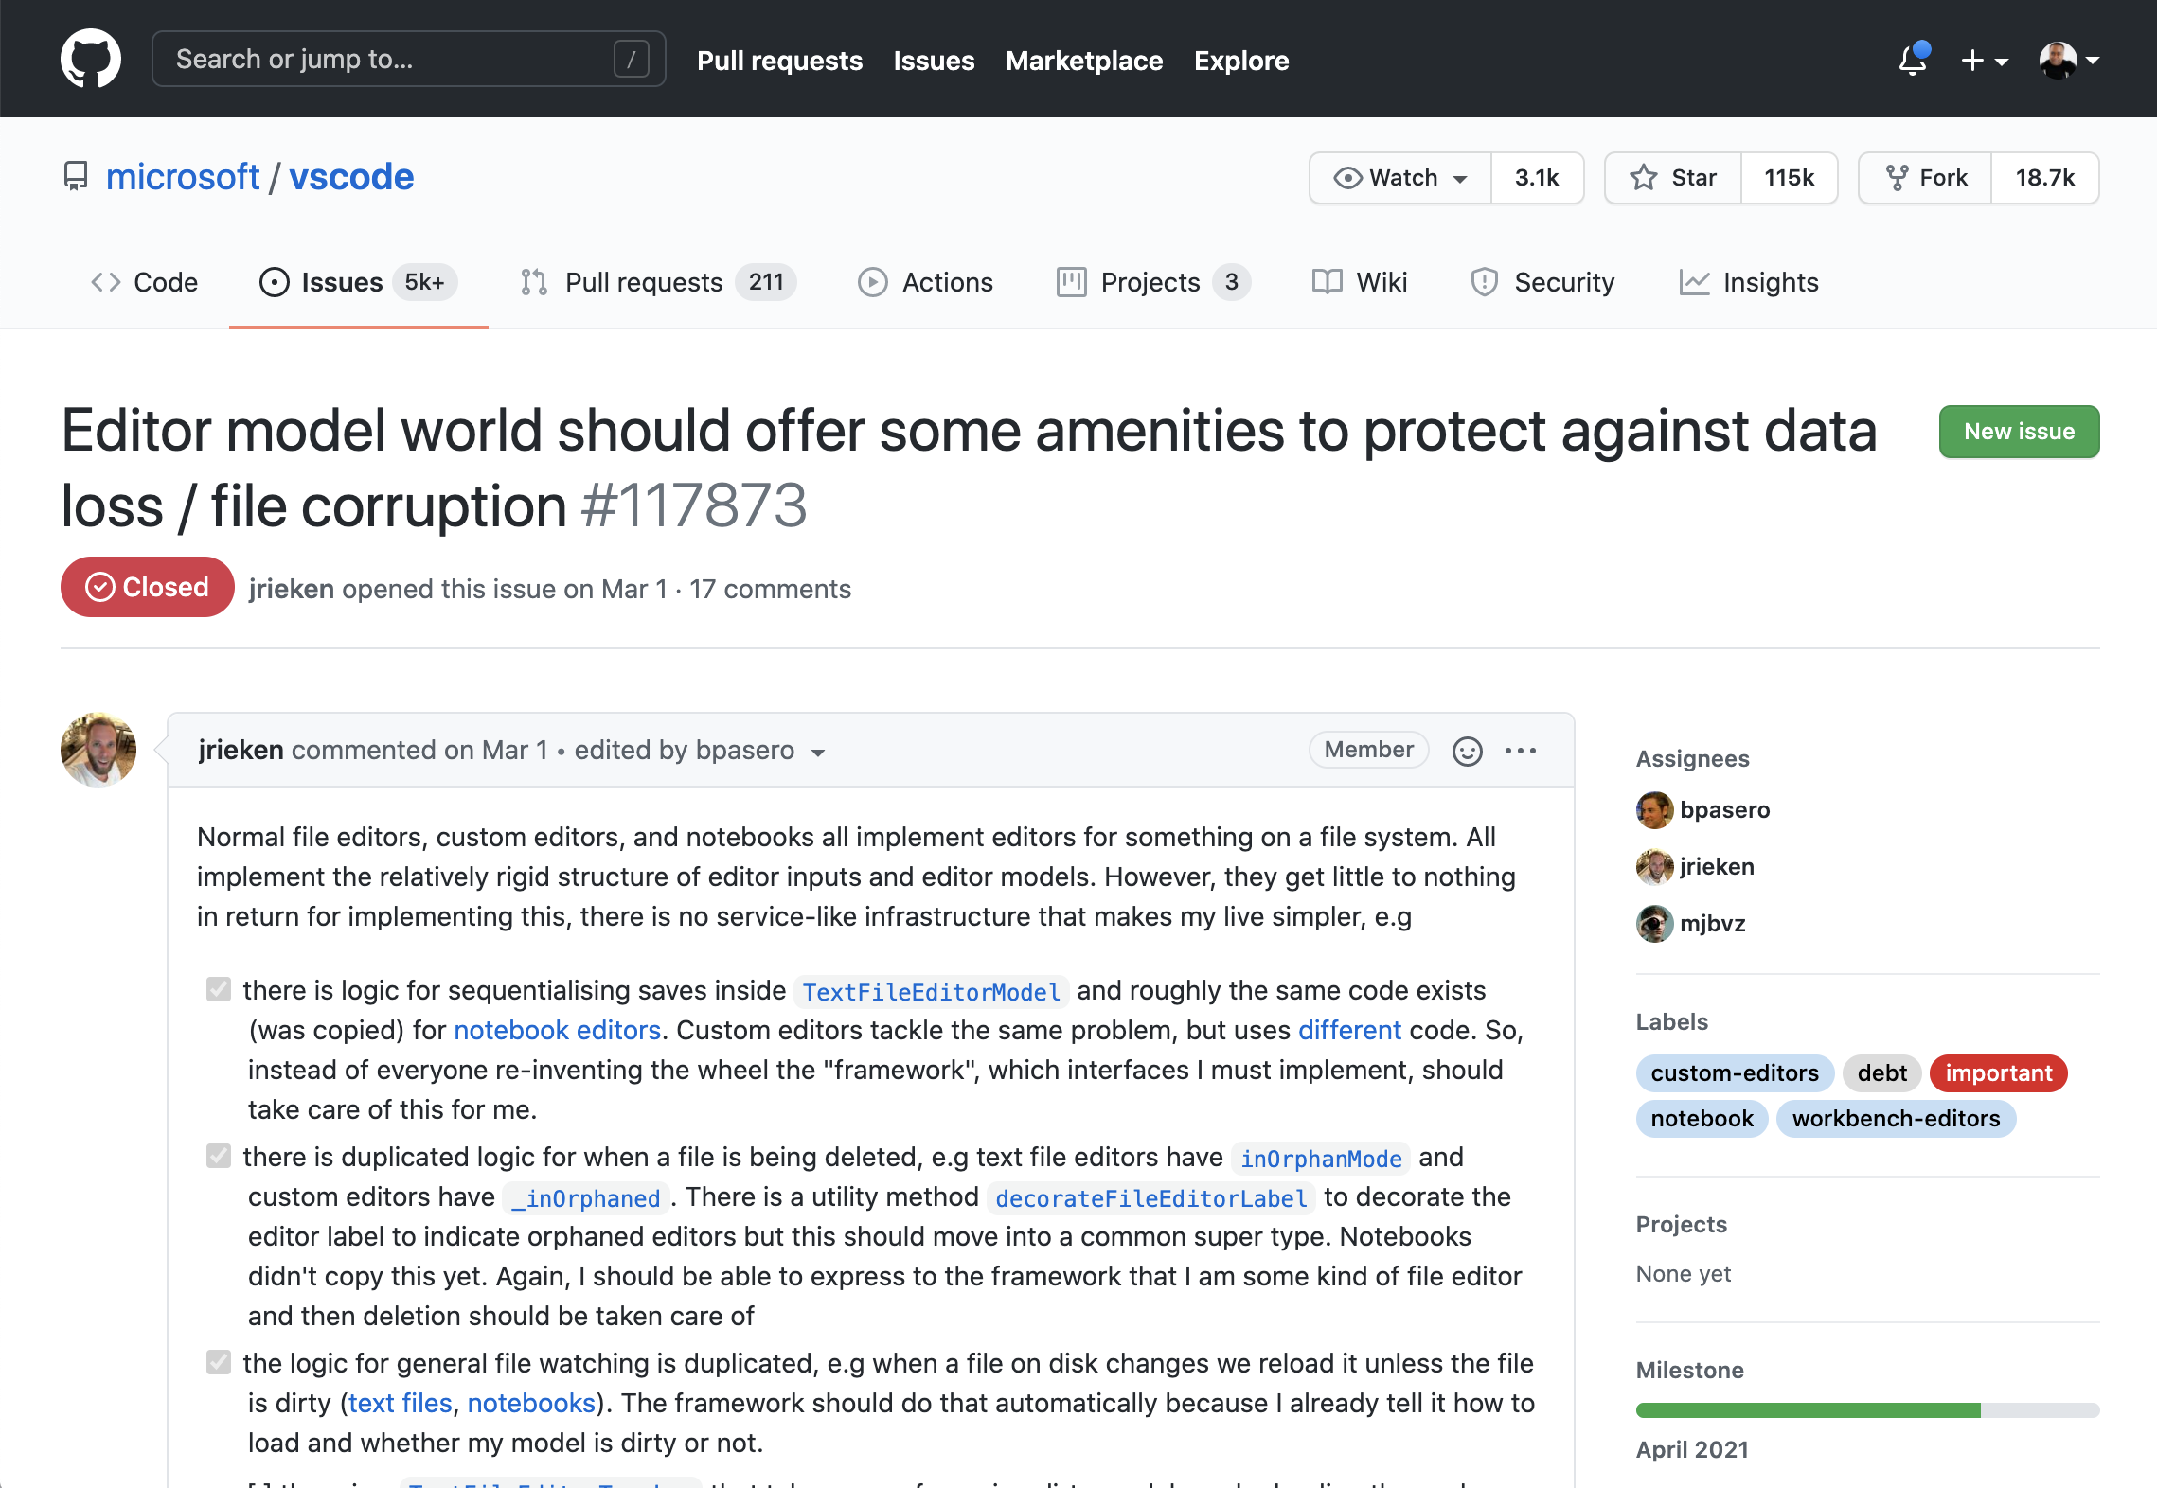
Example issue
with labels
Notes:
You can search labels and they make it easy to get a quick overview of what a project is about at a quick glance. This slide demonstrates this point.

Slide 18
Questions
Notes:
********************
Note to presenter:
The questions below are for your reference only. They are ones that you can anticipate receiving from the audience. However, there is no need to pose these to your audience.
********************
Q: Labels are only for issues? Not for repos and projects?
A: Labels are only for issues and pull requests. Repos can have "topics".

Slide 19
Tracking progress with milestones

Slide 20
Milestones
Use milestones to track progress on groups of issues or pull requests in a repository.
Notes:
Milestones
Milestones refer to project goals. Track progress using milestones.
********
Resources
https://docs.github.com/en/github/managing-your-work-on-github/about-milestones
********

Slide 21
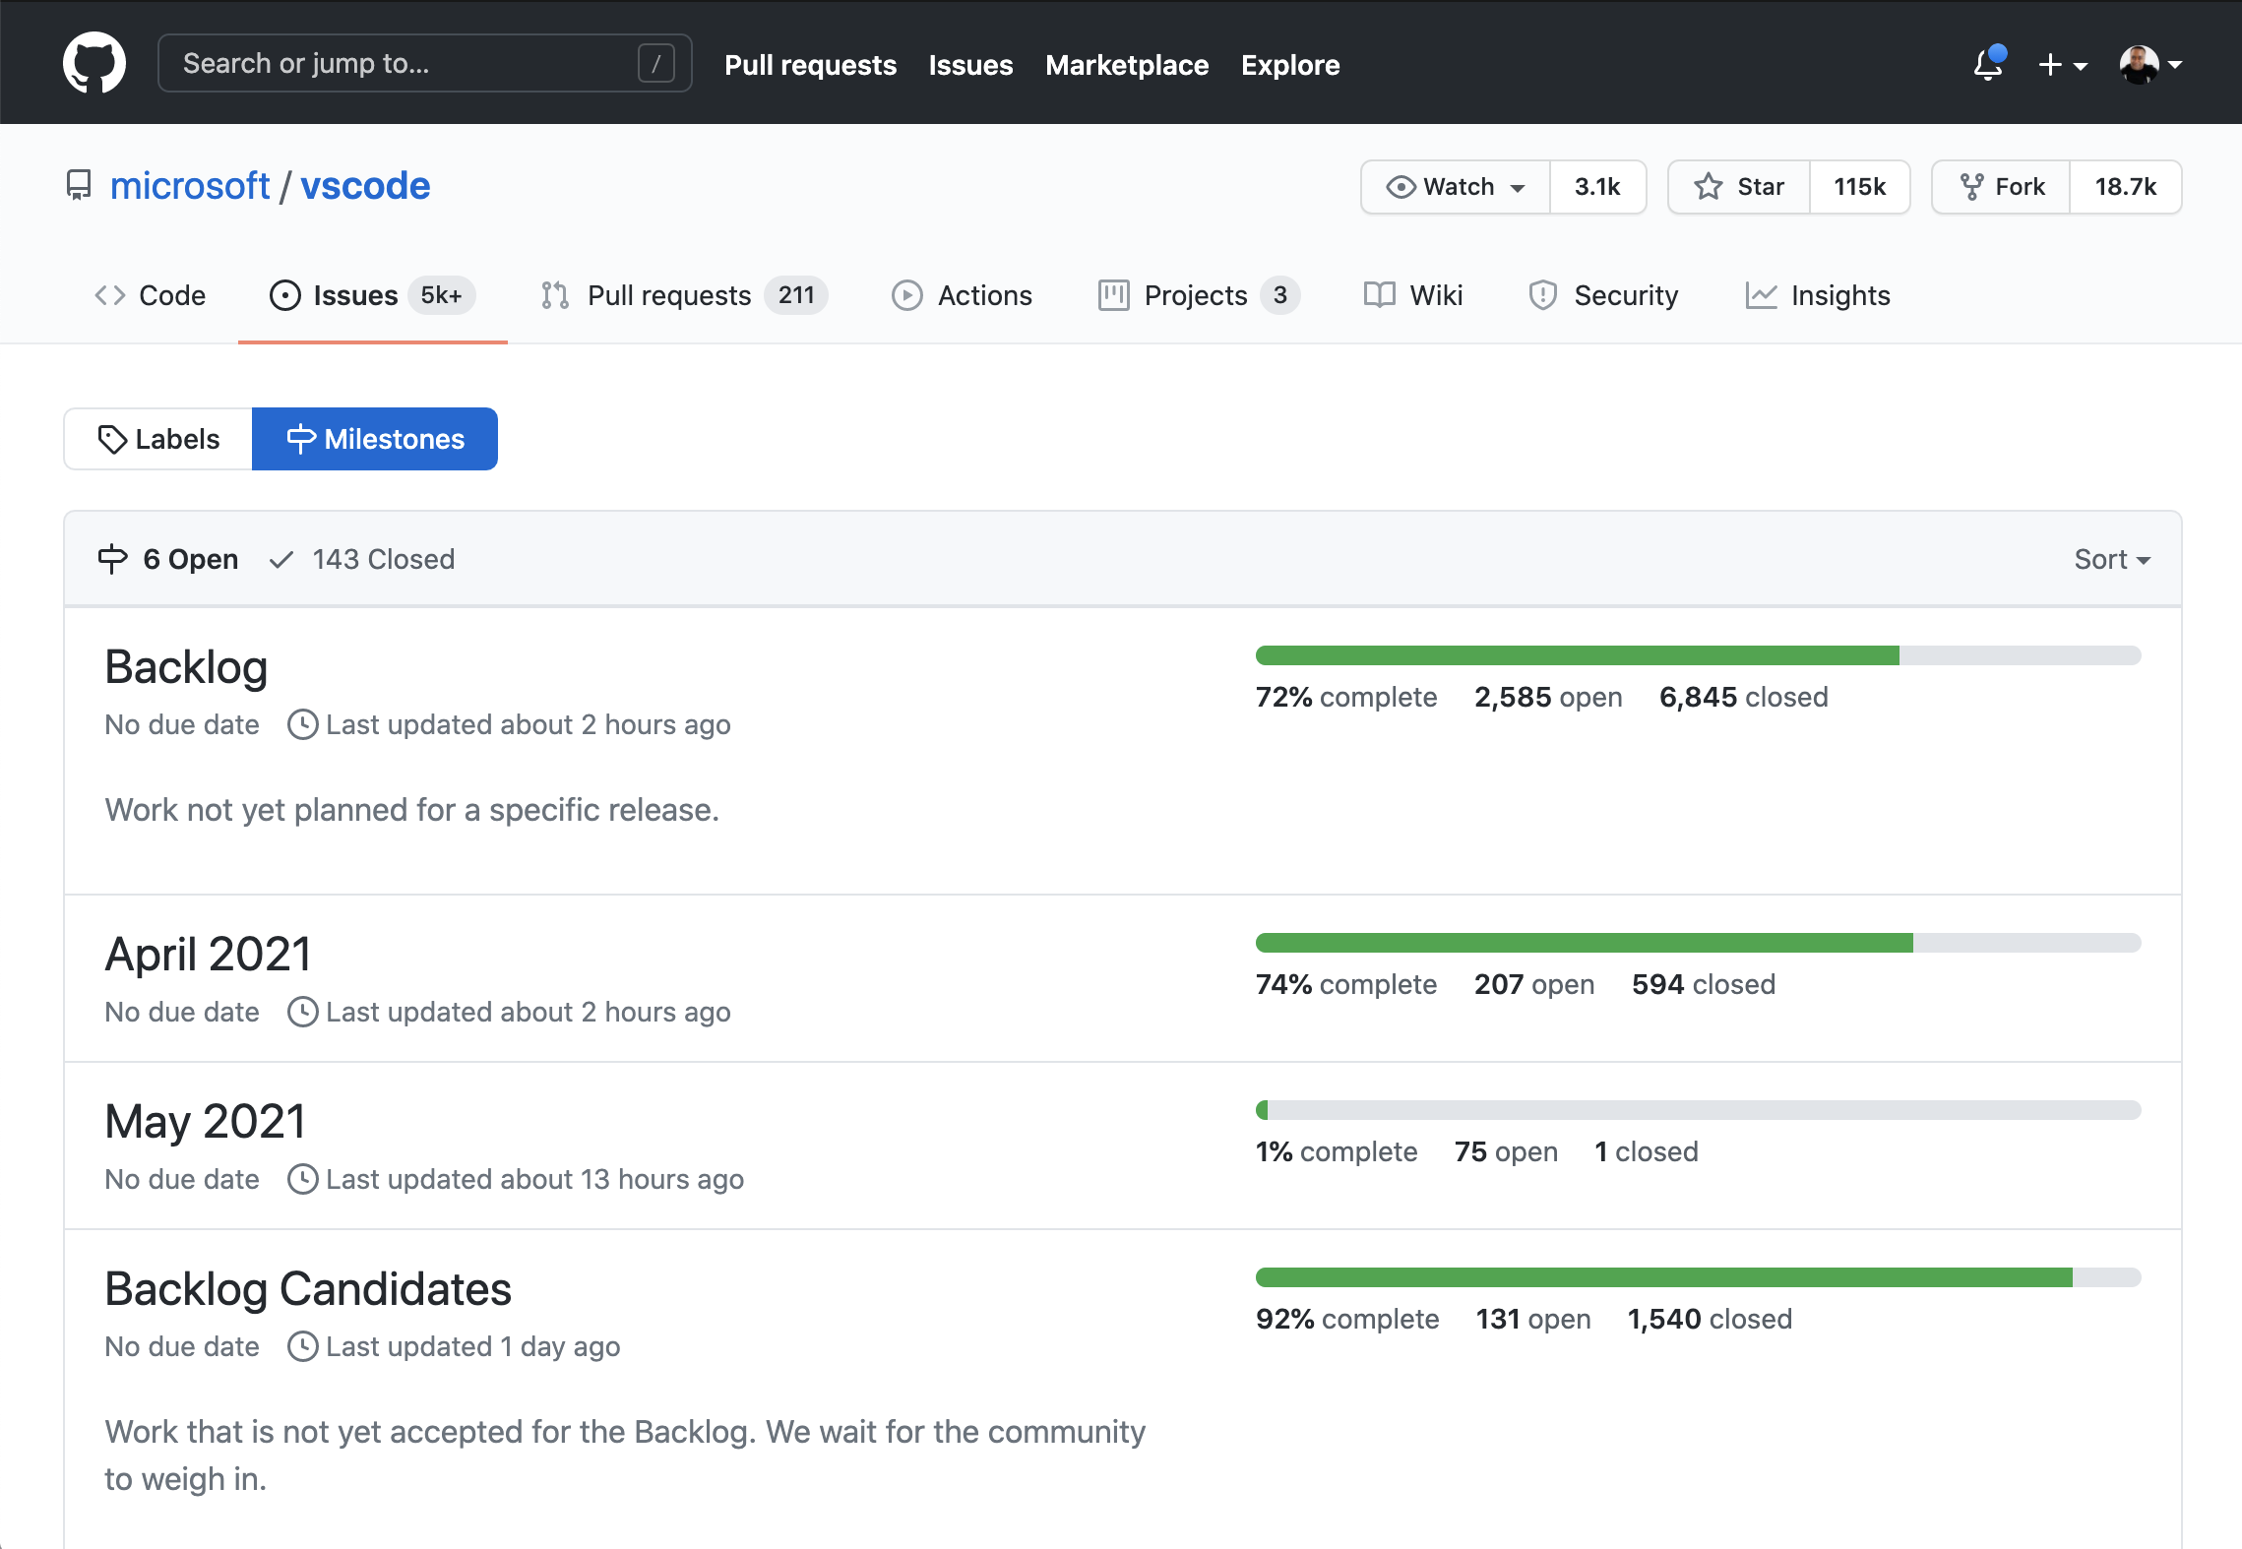
An example of milestones
Notes:
Define milestones at the repository level at "/milestones". See progress toward each milestone
Milestones are also useful if you have a lot of issues inside of a repository to track. Essentially, you can group them together in a milestone and give them a due date.
After you have made the assignment of groups of issues or PRs, GitHub gives you a visual representation using a progress bar. If you create a brand new milestone here and in slash milestones in your repository you give it like a due date.
If you choose to use other tools such as Azure boards to track progress, GitHub can be easily integrated.
********
Resources
https://github.com/microsoft/vscode/milestones
********

Slide 22
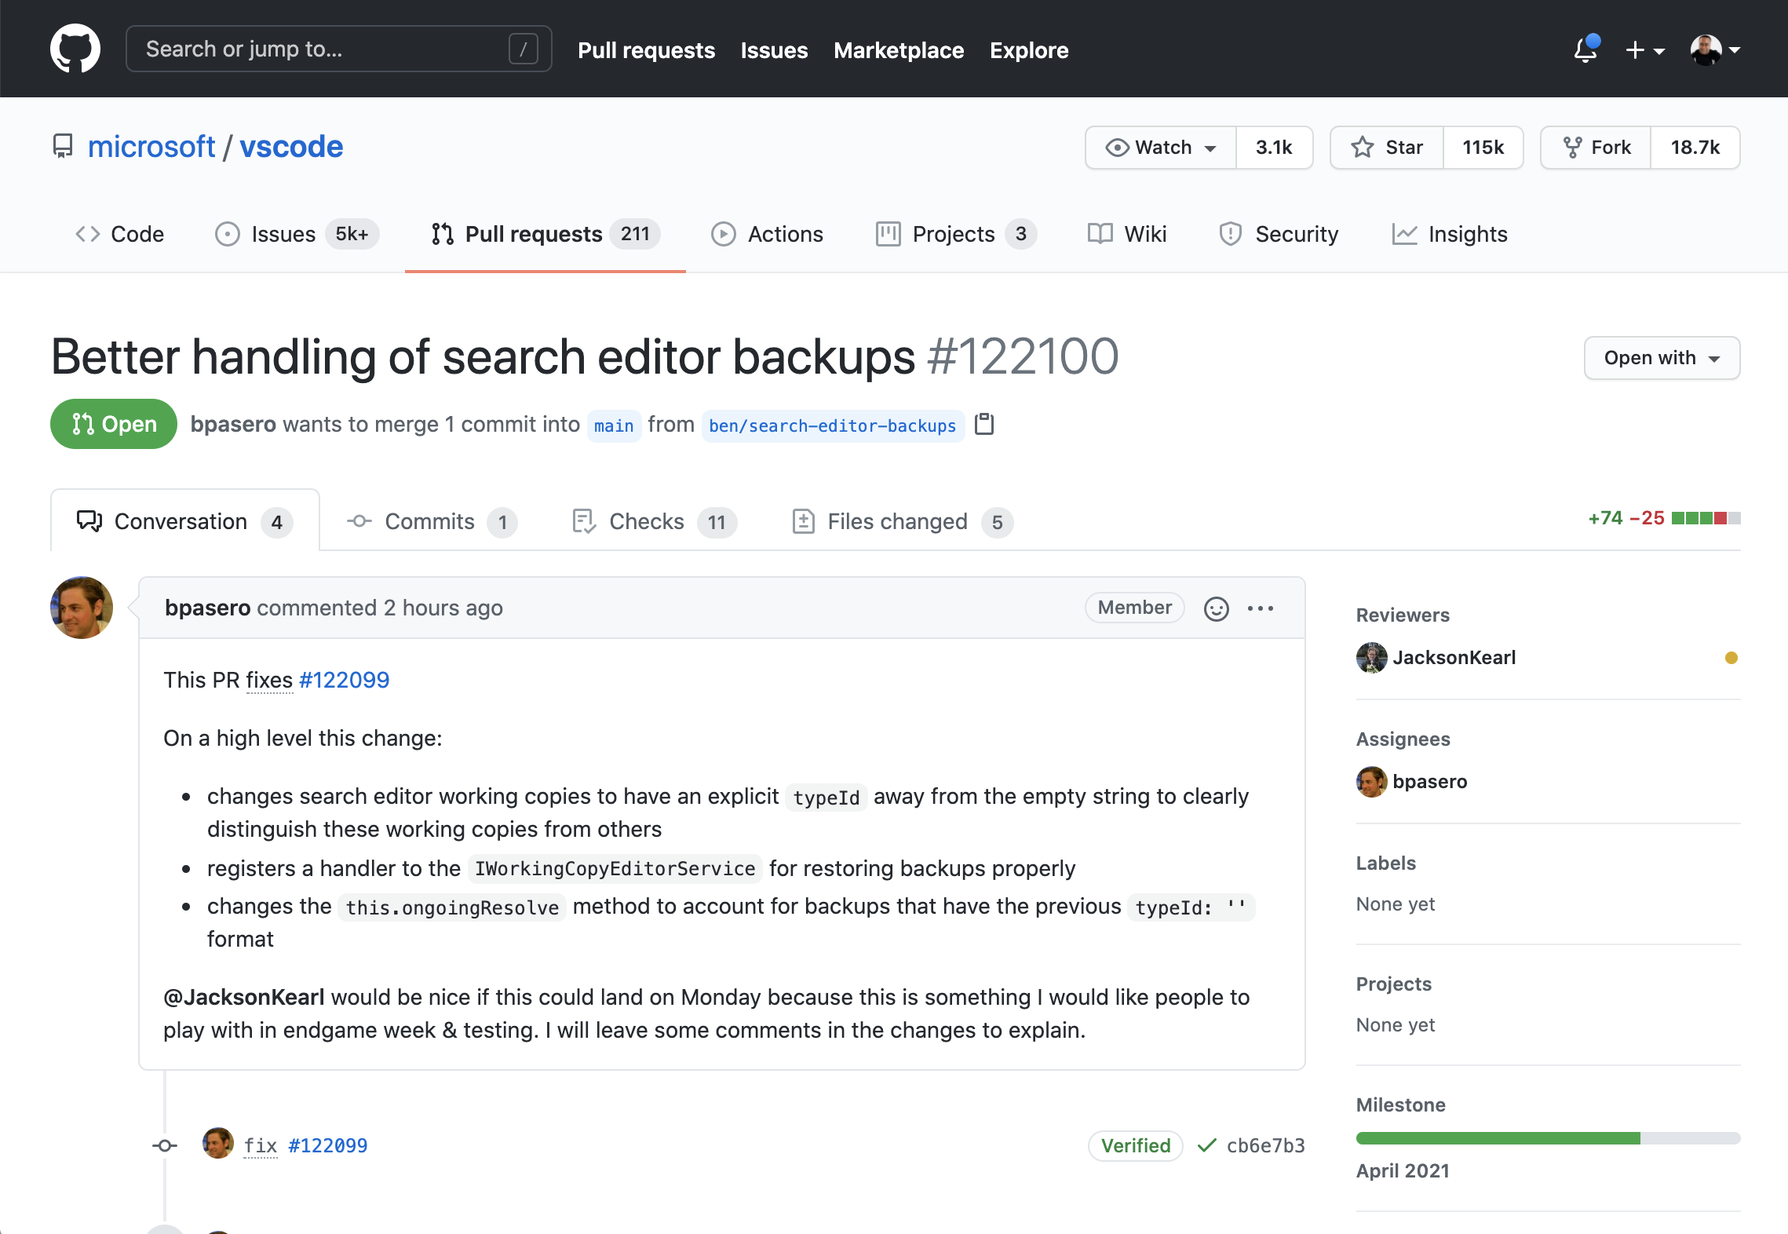
Progress bar
Notes:
This slide shows the progress bar directly to the right of the screen. This is where you would assign an issue or pull request to a milestone directly. This is useful if you already have an issue but still need to assign it to a newly created milestone.
Assign milestones in the issue or pull request
***************
References:
https://github.com/microsoft/vscode/issues/40262
**************

Slide 23
Tracking releases

Slide 24
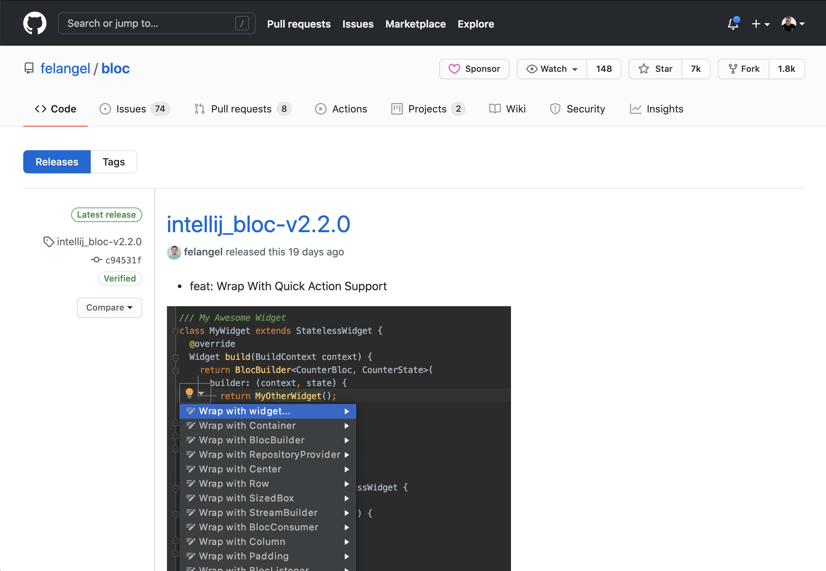
Releases and tags
Milestones, tags and releases to get a nice release cycle
Notes:
Releases and tags are used to help you manage your release cycle. Sometimes we'll see teams that depend on the git SHA to identify major releases when auditing source code and making sure that their traceability is always intact.
The screen shows and example of the repository section listing releases. https://github.com/felangel/bloc/releases
However, there is a better way of reaching the same goal: using tags and marking those as releases. Tags is a built-in git feature that GitHub uses to provide you with the flexibility in identifying major or minor releases or patch fixes.
Marking with tags allows you to see the state of the repos at a specific point in time.

Slide 25
Questions
Notes:
********************
Note to presenter:
The questions below are for your reference only. They are ones that you can anticipate receiving from the audience. However, there is no need to pose these to your audience.
********************
Q: Can issues/PRs belong to multiple milestones?
A: Yes!
Q: Regarding milestones, how common is it to track the backlog as a milestone?
A: It is up to the team - we see some teams use milestones in conjunction with projects to track things like backlogs, but often teams are looking for more structure than is provided in milestones alone.
Q: Closing things on milestone - does it sync to issues and projects?
A: ? (need to test)

Slide 26
Project board management

Slide 27
Project boards
Organize and prioritize work for specific features, comprehensive roadmaps, or even release checklists
Automation & flexibility
Notes:
Use project boards when you need to:
Manage a large amount of issues
Track small tasks or reminders. You can add cards for this purpose.
Visualize progress
Designate work to be done
Automate boards
Capture an idea in a card
You can change a card into an issue at any time.
Project boards on GitHub help you organize and prioritize your work. You can create project boards for specific feature work, comprehensive roadmaps, or even release checklists. With project boards, you have the flexibility to create customized workflows that suit your needs.
To insure that the commits that you make to your repository are tied to business requirements and remain traceable, project boards help you keep organized and prioritize your work.
Made up of issues, pull requests, and notes that are categorized as cards in columns of your choosing.
You can drag and drop or use keyboard shortcuts to reorder cards within a column, move cards from column to column, and change the order of columns.
Released around 2016 as the first way of visualizing issues. Using drag and drop, you can add issues that you need to keep track of. Although you may have a large number of issues in the repository, you can use project boards to keep track of only the ones that you choose.
********
Resources
https://docs.github.com/en/github/managing-your-work-on-github/about-project-boards
********

Slide 28
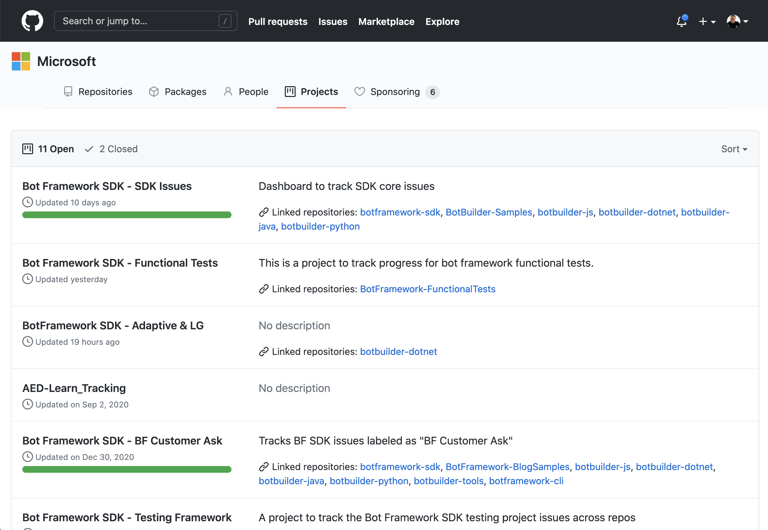
Organization and user level project boards
Milestones, tags and releases to get a nice release cycle
Notes:
Use project boards at both the organization and repository level. Project boards can be created at the organization/user level...
Multiple projects are supported.
The image on this slide illustrates project boards on an organizational level. Microsoft is the organization. Six project boards exist.
Note: The screen shot was taken from https://github.com/orgs/microsoft/projects

Slide 29
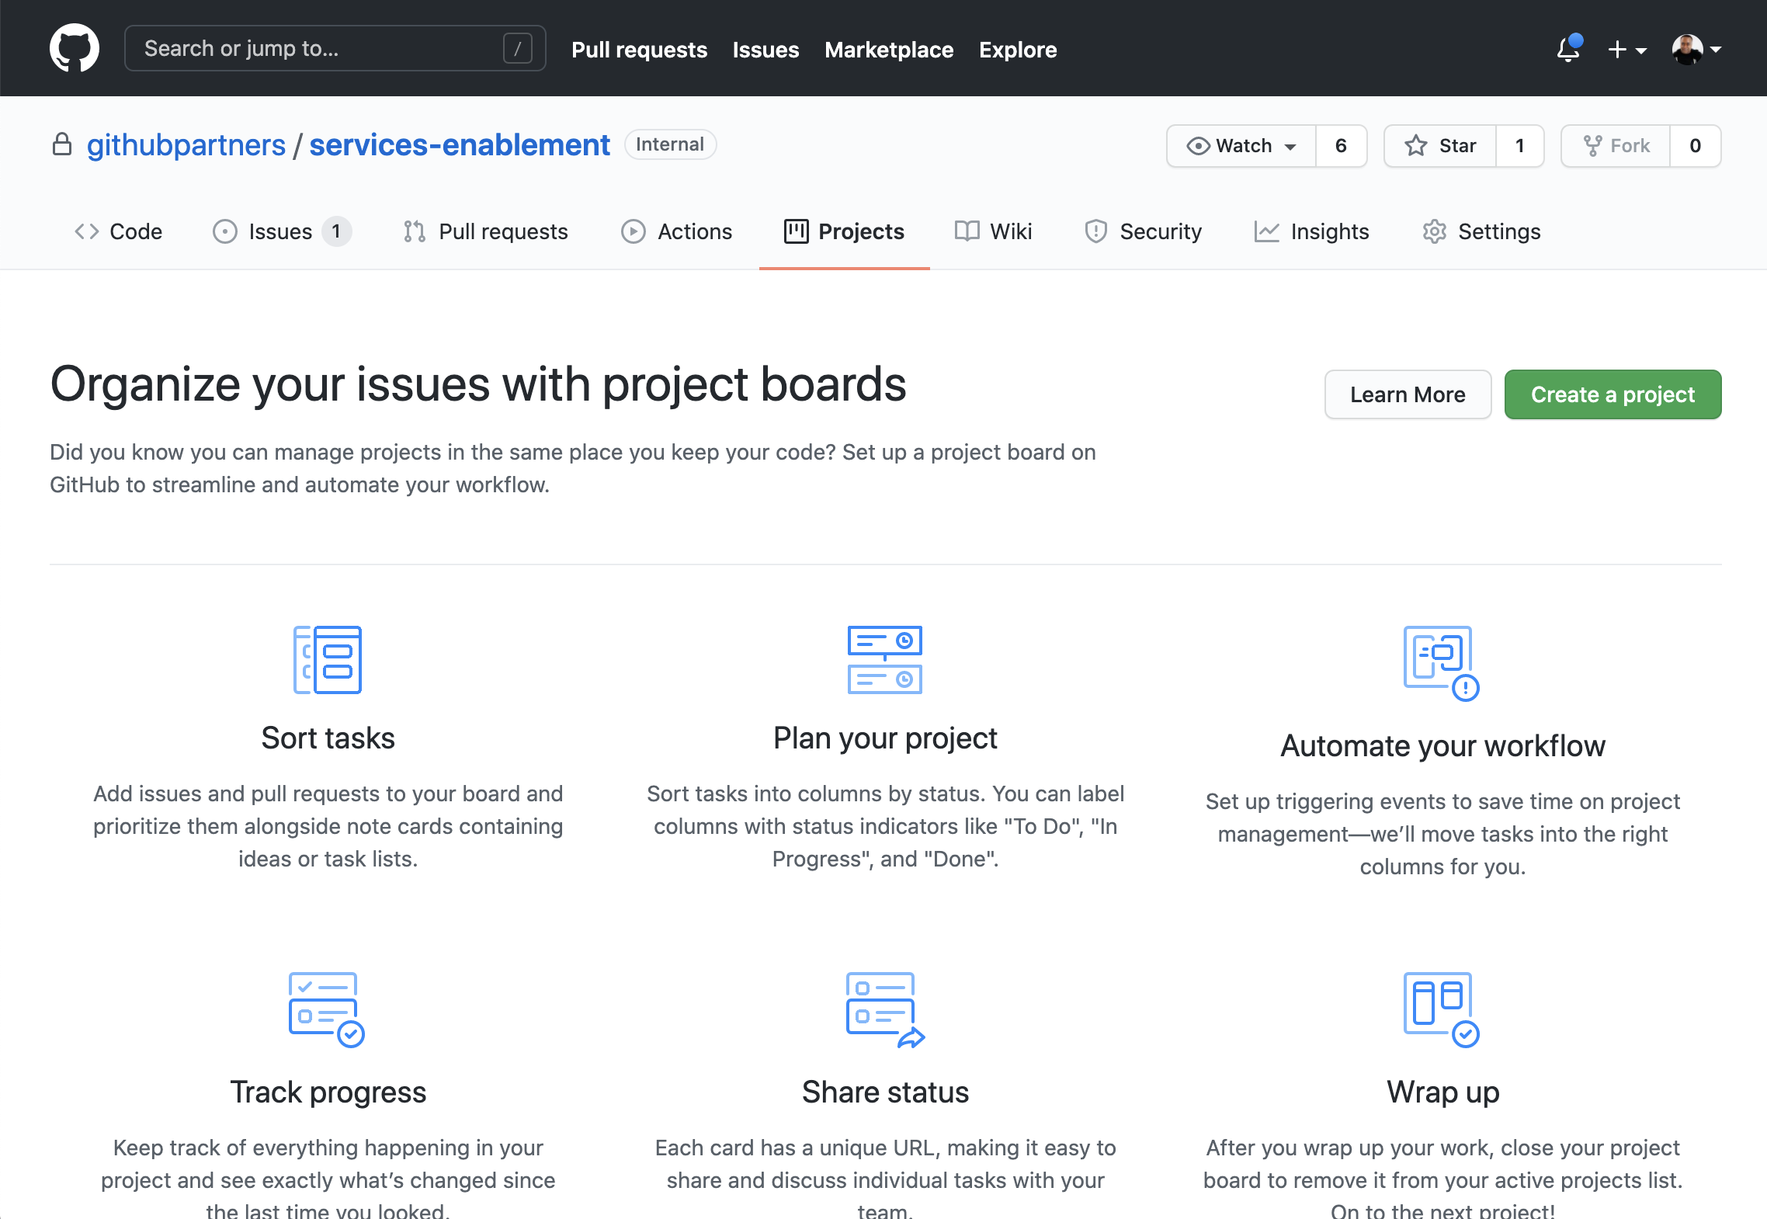
Repository level project boards
Notes:
Here we see the project boards at the repository level.
Notice the URL format is /owner/repository_name/projects. From this view you can create a new project at the repo level.
It is noteworthy that making project boards visible on an organizational level can encourage collaboration among teams.

Slide 30
Track progress with project boards
View state of work
Drag and drop
Column format with automation
Notes:
Project boards can be used to see different states of work (open, pending, closed, etc)
You can drag cards across columns to visualize states
The full body of work can be made visible from a project board. View the status of work. Set various columns to represent those stages. Place the cards that represent your issues into each of the columns. This layout gives you another option of visualizing your work.

Slide 31
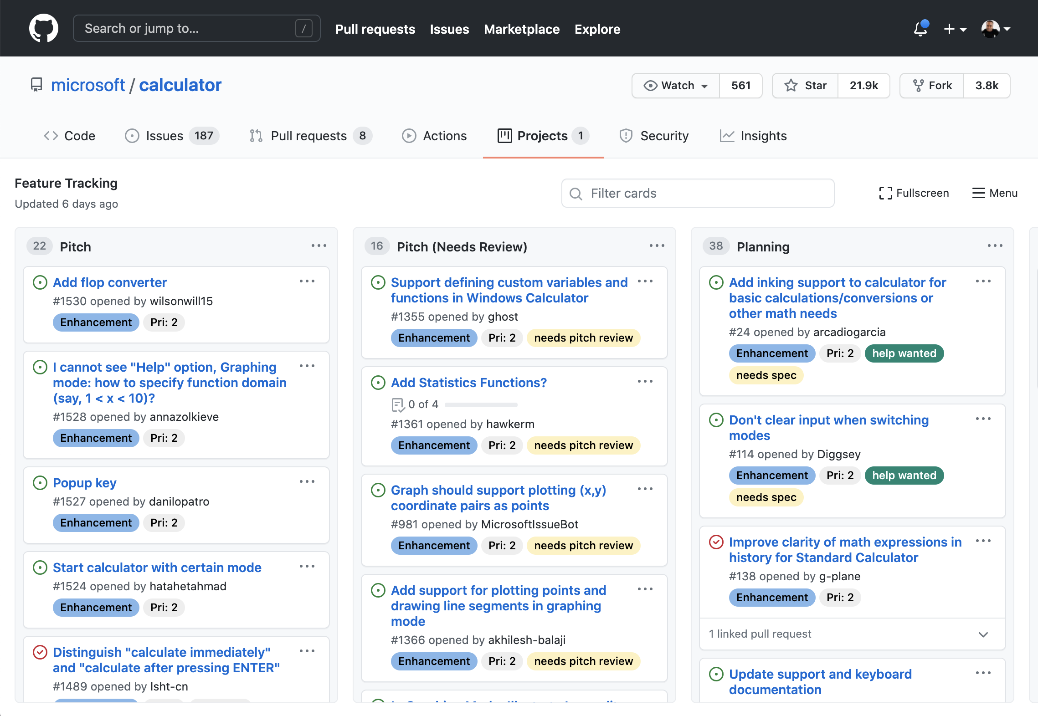
Use columns to visualize work​
Milestones, tags and releases to get a nice release cycle
Notes:
Columns are used to:
Track states
Track specific owners of various tasks
Monitor backlog
Triage priority
Flag tasks that are blocked
Note that you can define your own columns. Automation for column change is also supported.
Reference: https://github.com/microsoft/calculator/projects/1

Slide 32
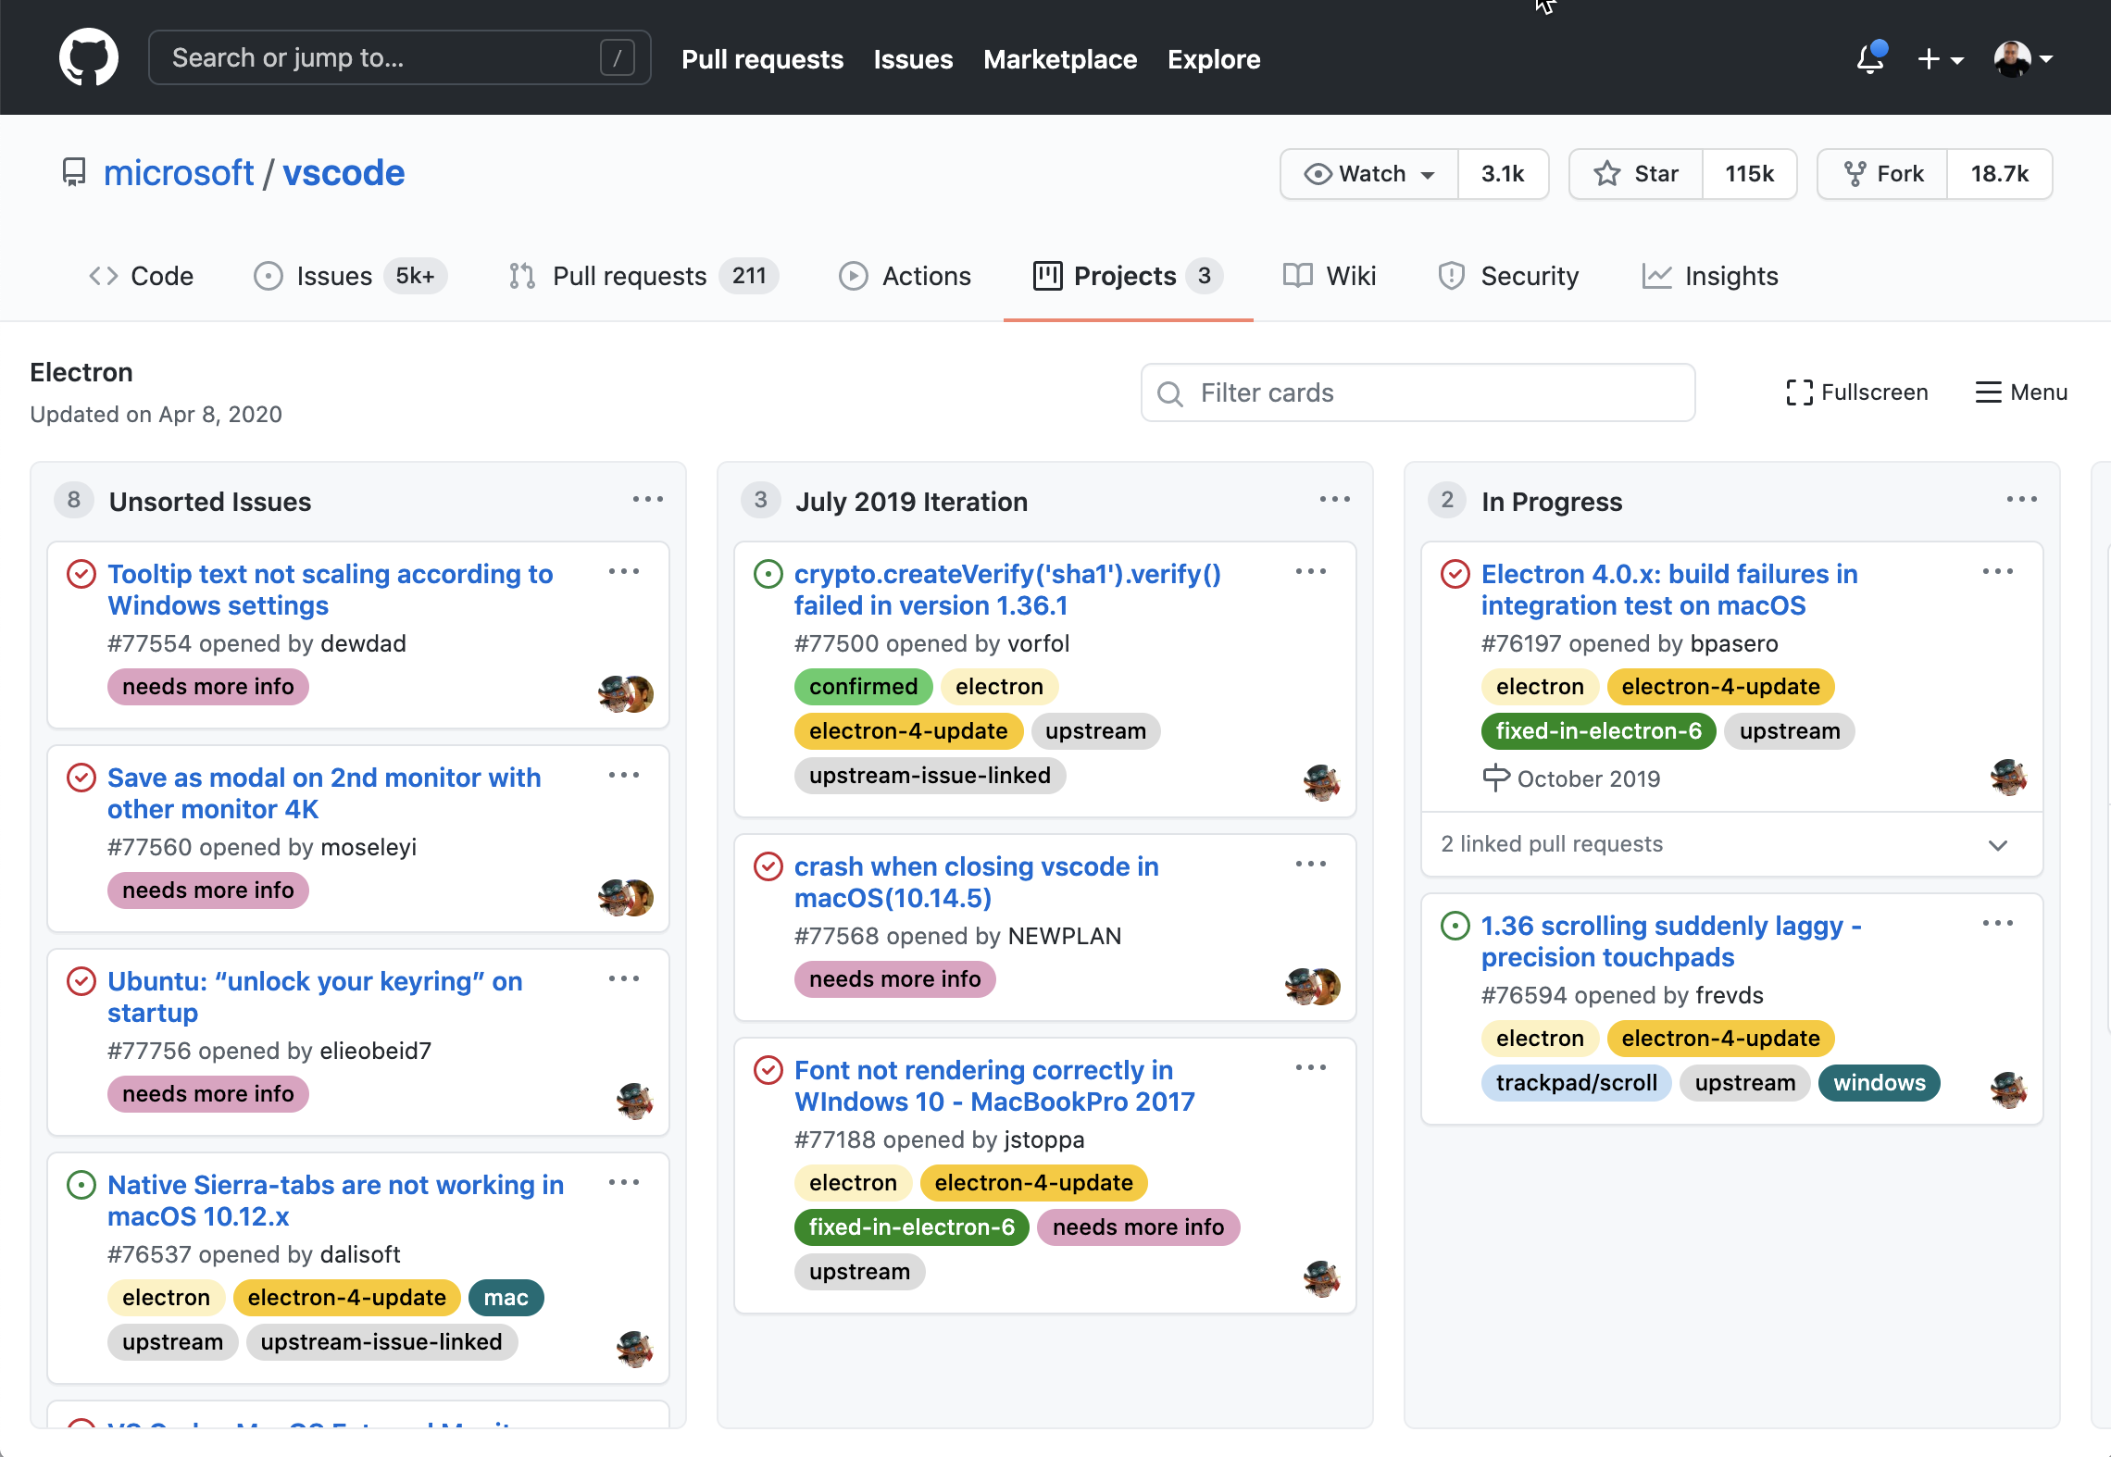
See milestones on​ a project board
Notes:
Inside of a project board, issues can be tied to milestones and are labeled accordingly.
So, planning is another useful function of project boards. The project board serves as a sort of epic in this scenario.
Reference: https://github.com/microsoft/vscode/projects/6

Slide 33
Questions
Notes:
********************
Note to presenter:
The questions below are for your reference only. They are ones that you can anticipate receiving from the audience. However, there is no need to pose these to your audience.
********************
Q: Can I have a public project on a private repo?
A: No
Q: Are private projects assigned to your default team or do you have to explicitly add collaborators?
A: If the project is within a repository, then those repository permissions apply. If it's within an org, then org permissions apply.
Q: Do you have any guidance/best practices to share regarding Projects and having PRs on the board? To me, having a PR as a separate card on a Kanban board is weird…
A: Indeed, before when the linked PRs where not a thing it was needed
currently, I recommend only to have notes and issues as the linked PRs already appear there
Q: Will there be more fine grained rules for board automations? Like "add new issues with label X to ToDo"?
A: As of now, only the automations tied to the current implementation are available. So, if you were to call the GitHub API through an action you could add a label to an issue.

Slide 34
Find information in a repository

Slide 35
Filters
You can find information by filtering on issues, pull requests, assignees, labels, and more.
Notes:
You can find information by filtering on issues, pull requests, assignees, labels, etc...
*********************
Resources
https://help.github.com/en/github/managing-your-work-on-github/finding-information-in-a-repository
*********************

Slide 36
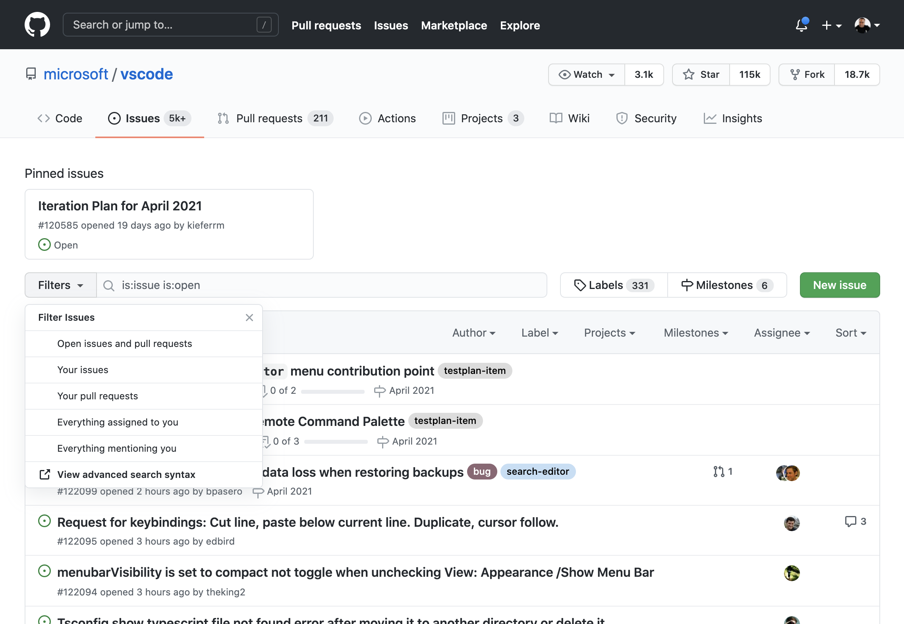
Filters
Notes:
Here we see the dropdown that can be used to select presets for how you would like to filter your issue search.
Reference: https://github.com/microsoft/vscode/issues
Specify:
Open issues and pull requests
Your issues
Your pull requests
Everything assigned to or mentioning you

Slide 37
Filter Text Box
Notes:
After using the presets, you can filter using the text box. Use the filter text box to fine tune your search.
On the screen you can see that the search was for a bug and the corresponding labels appear.
Reference: https://github.com/microsoft/vscode/issues

Slide 38
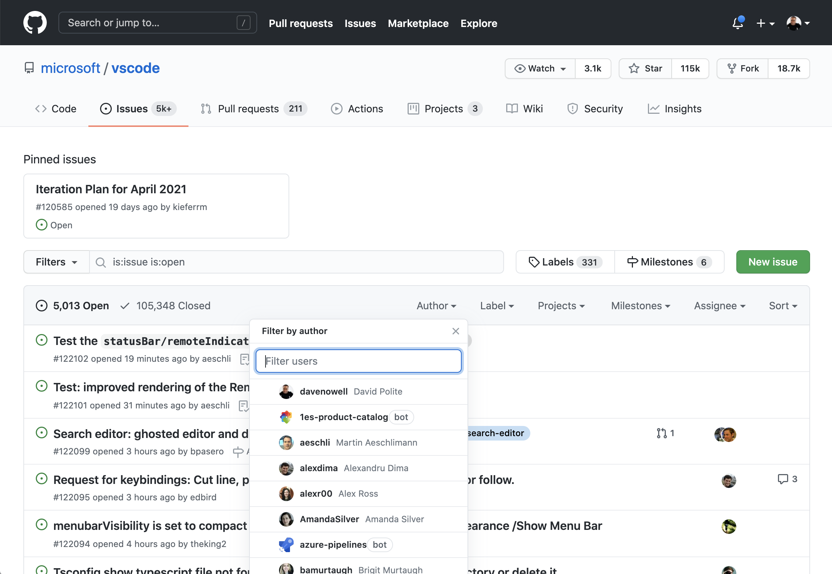
Drop-downs for author search
Notes:
Drill down and filter on authors. Use the text box “filter by author” to find the author that you would like to search for.
Reference: https://github.com/microsoft/vscode/issues

Slide 39
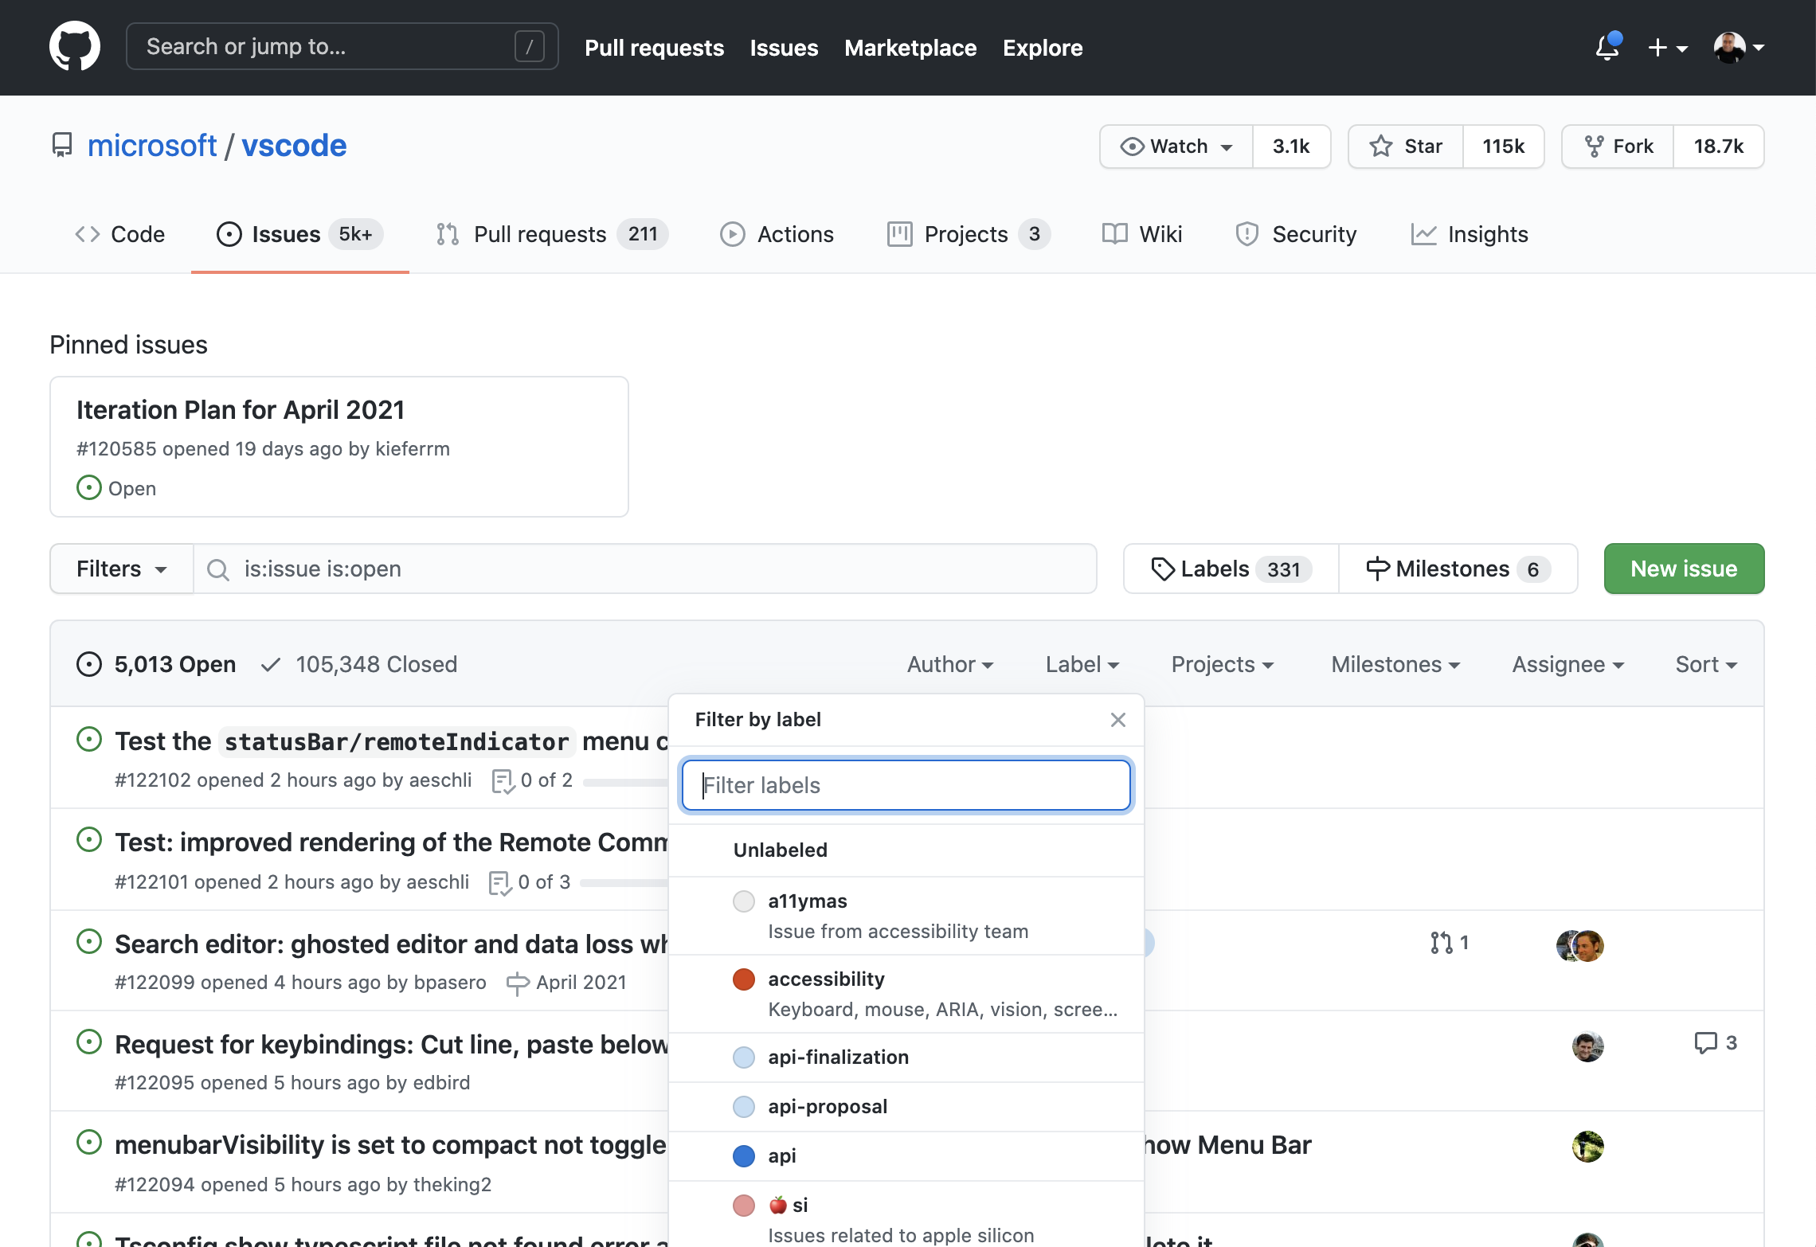
Drop-downs to search for labels
Notes:
Drill down and filter on labels. Use the text box “filter labels” to find the label that you would like to search for.
Reference: https://github.com/microsoft/vscode/issues

Slide 40
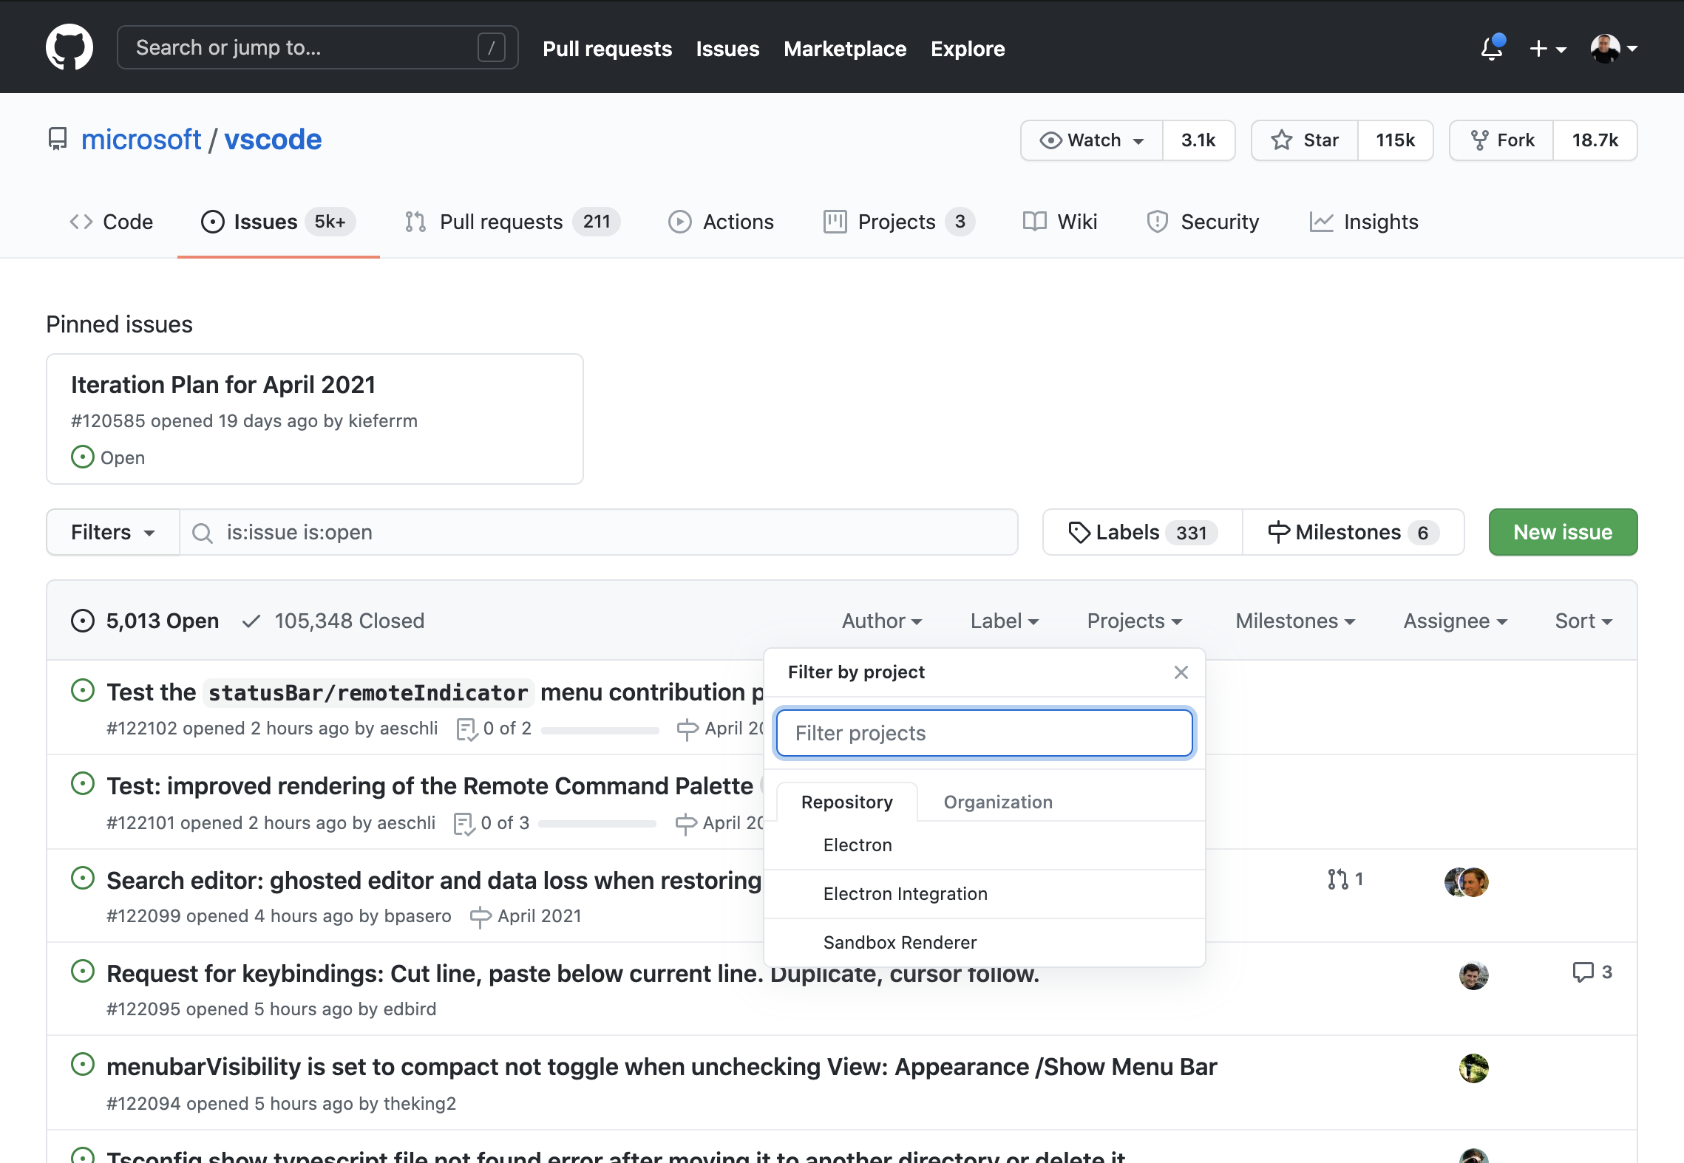
Drop-downs to search for projects
Notes:
Drill down and filter on projects. Use the text box “filter projects” to find the repository or organization that you would like to search for. Use the tabs to specify the repository or organization that you would like to filter.
Reference: https://github.com/microsoft/vscode/issues

Slide 41
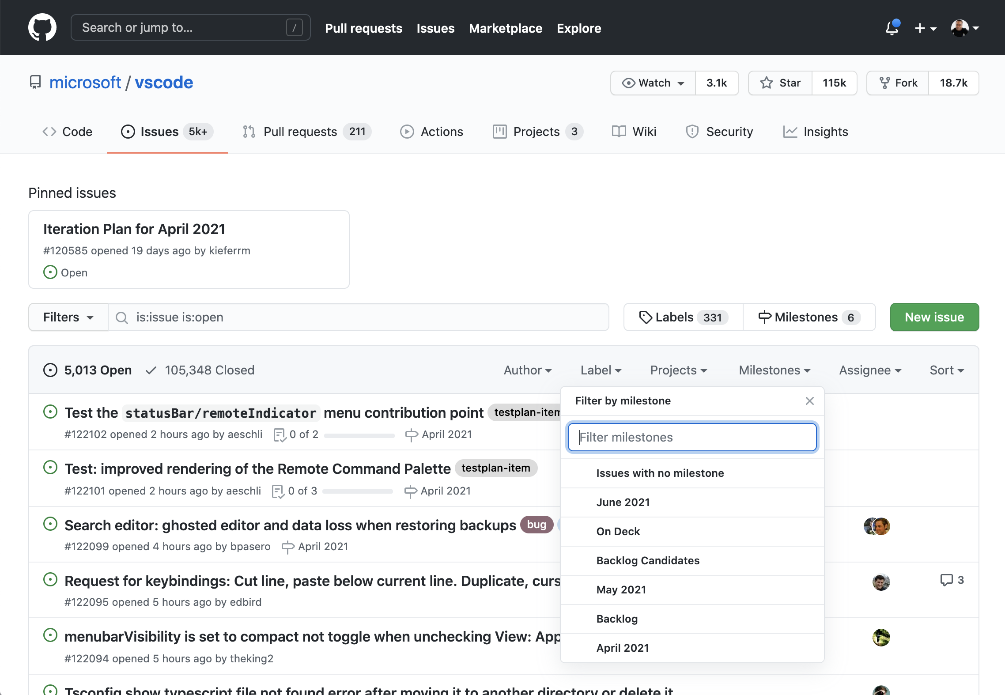
Drop-downs to search for milestones
Notes:
Drill down and filter on milestones. Use the text box “filter milestones” to find the milestone that you would like to search for.
Reference: https://github.com/microsoft/vscode/issues

Slide 42
Notifications

Slide 43
Manage notifications
Provide updates
Triggered by activity on GitHub
Customize notification settings
Notes:
Notifications provide updates about the activity on GitHub that you've subscribed to. You can use the notifications inbox to customize, triage, and manage your updates.
Updated the experience to be like an email inbox
- Discuss the different things that can trigger notifications
********
Resources
https://docs.github.com/en/github/managing-subscriptions-and-notifications-on-github/about-notifications
********

Slide 44
Notes:
So, if you are @mentioned in an issue, the blue dot on the bell icon appears to notify you.

Slide 45
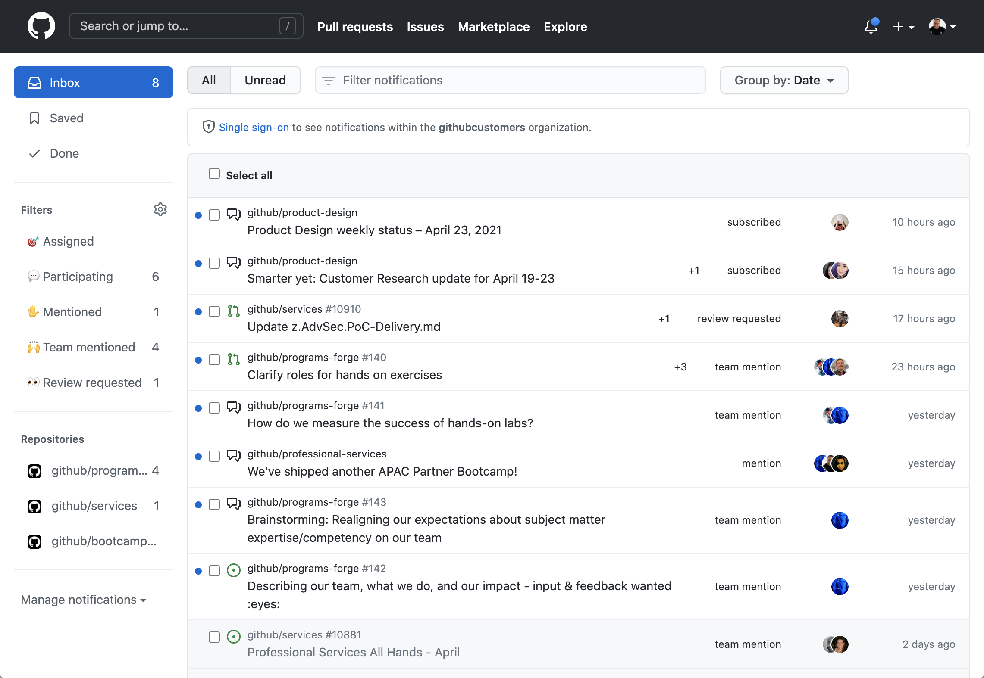
Notifications
Notes:
The notifications inbox helps you stay on top of conversations
The updated view of the inbox is extremely useful in managing your notifications. Filters exist on the notifications page. Even in the GitHub app, you receive notifications.
See https://github.com/notifications
This screen outlines reasons why you would be subscribed to an issue.
In general, you are automatically subscribed to conversations by default when you have:
Not disabled automatic watching for repositories or teams you've joined in your notification settings
Been assigned to an issue or pull request
Opened a pull request, issue, or created a team discussion post
Commented on a thread
Subscribed to a thread manually by clicking Watch or Subscribe
Had your username @mentioned
Changed the state of a thread, such as by closing an issue or merging a pull request
Had a team you're a member of @mentioned
By default, you also automatically watch all repositories that you create and are owned by your user account

Slide 46
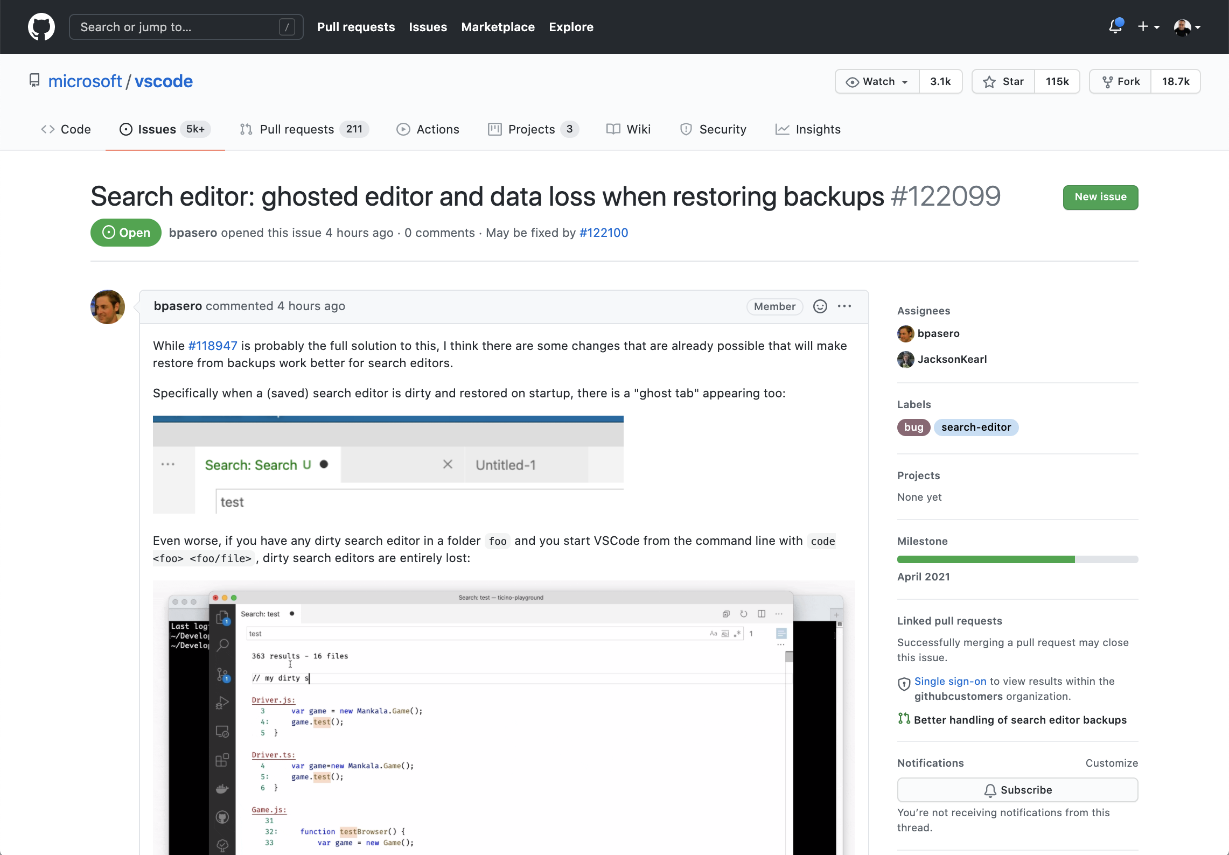
Subscribe
Notes:
You are automatically subscribed to conversations where you or your team is mentioned. You can also Subscribe to threads. Use the watch button to watch or unwatch activity on a repository.

Slide 47
Issue and pull request templates

Slide 48
Templates
Issue and pull request templates
Project board templates
Notes:
With issue and pull request templates, you can customize and standardize the information you'd like contributors to include when they open issues and pull requests in your repository.
You can have issue templates. They are a free form markdown based file in your repository used if somebody creates an issue in your repo, you can auto populate the body with markdown syntax styled text to guide them on what to write. Include assignees, labels, etc.
You can use templates to quickly set up a new project board. When you use a template to create a project board, your new board will include columns as well as cards with tips for using project boards. You can also choose a template with automation already configured.
********
Resources
https://docs.github.com/en/github/building-a-strong-community/about-issue-and-pull-request-templates
https://docs.github.com/en/github/managing-your-work-on-github/about-project-boards#templates-for-project-boards
********

Slide 49
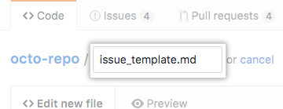
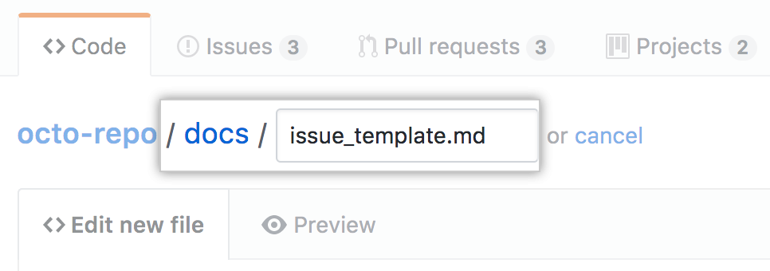
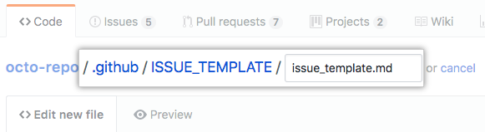
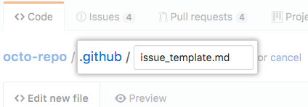
Issue template locations
Notes:
The screen shows the locations inside of a repository where the templates can be placed.

Slide 50
---
name: Tracking issue
about: Use this template for tracking new features.
title: "[DATE]: [FEATURE NAME]"
labels: tracking issue, needs triage
assignees: octocat
---
<body>
Notes:
The template can contain YAML front matter to automatically provide . The screen shows an example of front matter.
The name of the issue
A topic (seen here under “about”)
A title that uses variables such as the date or a feature name.
Labels
Assignees
So, you can see that this expediates issue creation.
**********************
Reference:
https://github.com/microsoft/vscode/blob/master/.github/ISSUE_TEMPLATE/feature_request.md
******************

Slide 51
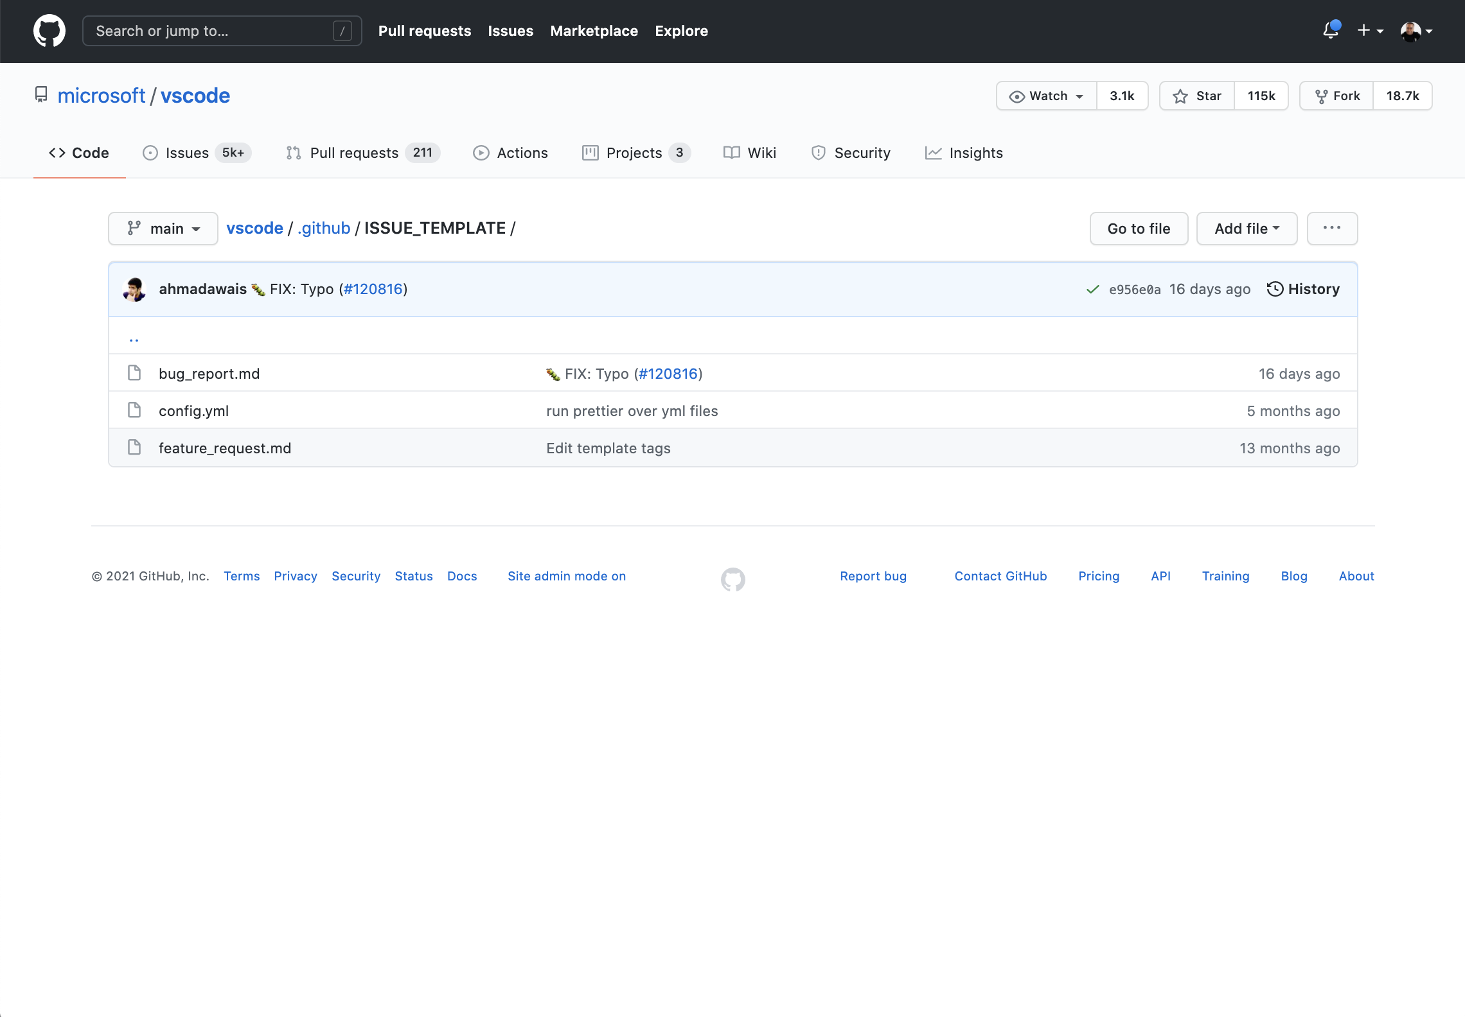
Multiple issue templates for one repository
Notes:
Use the .github directory to collect your templates.
Created in .github/ISSUE_TEMPLATE
Need to be on the default branch
The screen shows an example of multiple Issue Templates for a repository.
After the templates have been gathered in the .github directory, they are listed as seen on this screen.
It is important to note the benefit of having this sort of code in your repository. Generally speaking, very useful auditing and traceability can be tied to it.
Reference: https://github.com/microsoft/vscode/tree/master/.github/ISSUE_TEMPLATE

Slide 52
Templates to create issues

Slide 53
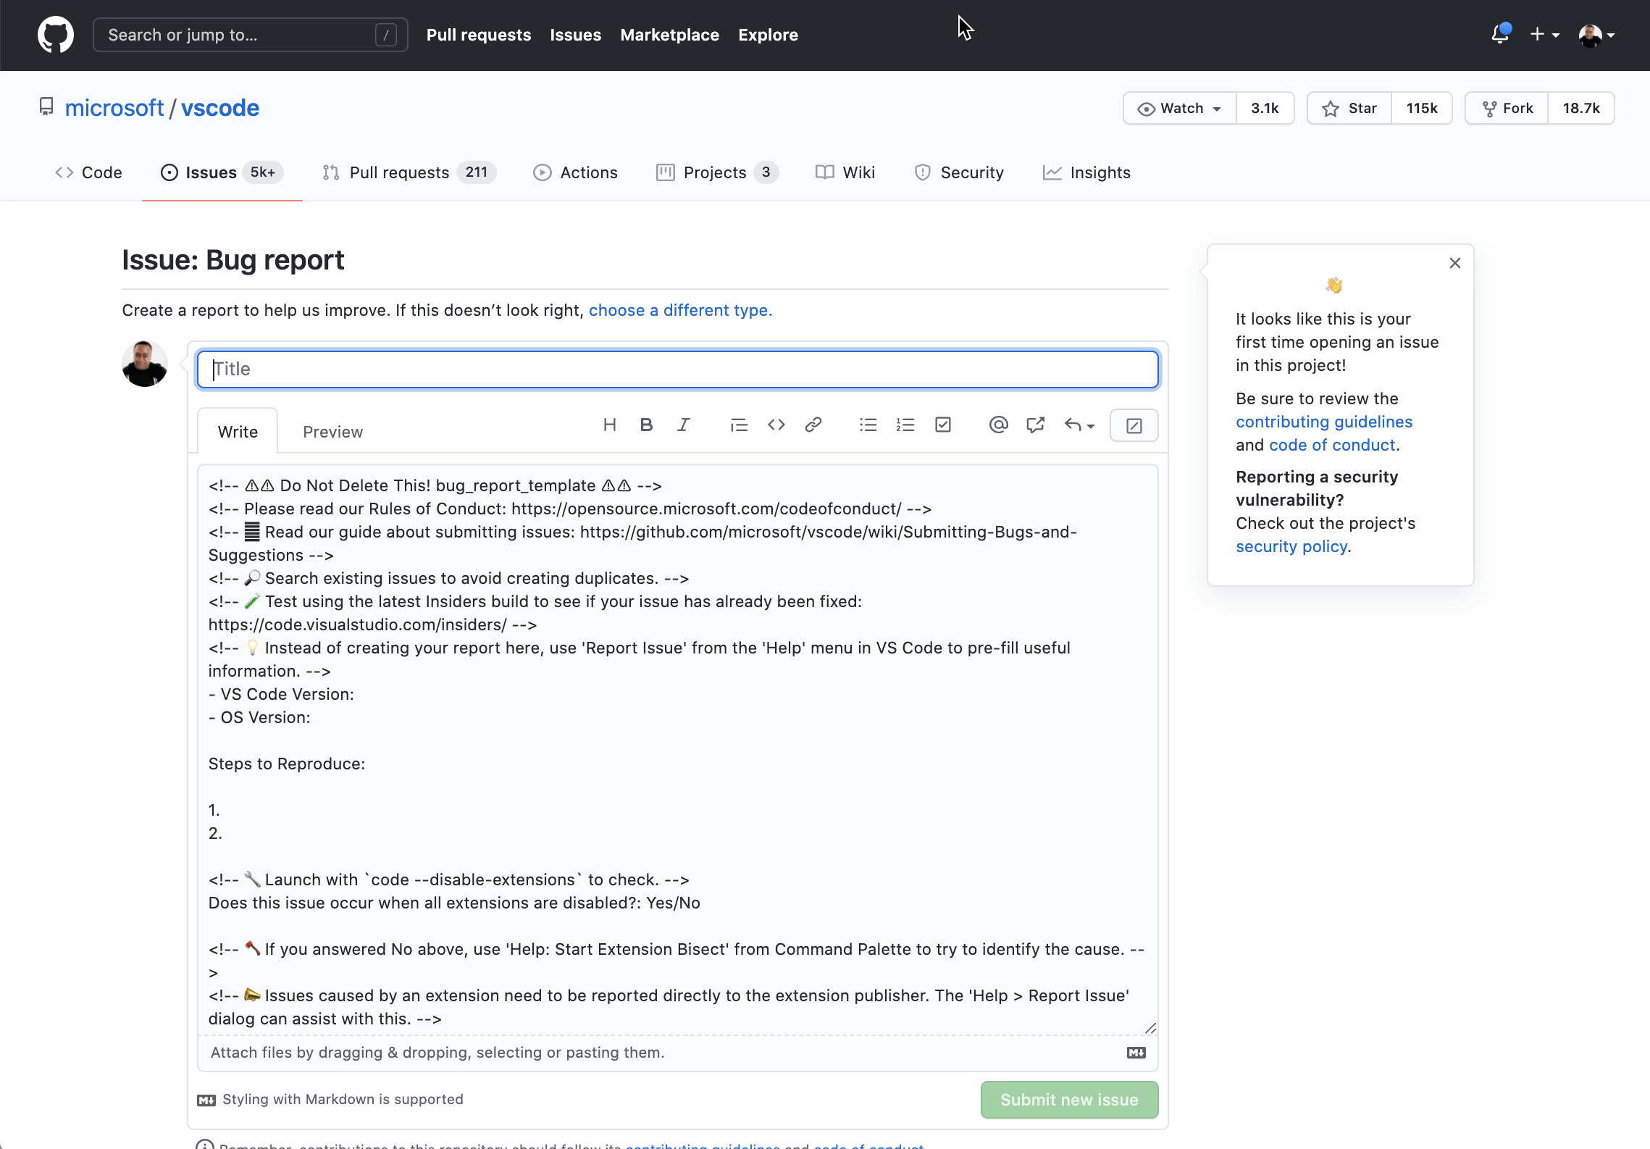
Template based title, body, assignee, and labels
Notes:
The screen shows what it looks like when you create a new issue based off of an issue template.
See https://github.com/microsoft/vscode/issues/new?template=bug_report.md

Slide 54
Project board templates
Template | Description
None | A blank board with no columns
Basic kanban | Track your tasks with To do, In progress, and Done columns
Automated kanban | Cards automatically move between To do, In progress, and Done columns
Automated kanban with review | Cards automatically move between To do, In progress, and Done columns, with additional triggers for pull request review status
Bug triage | Triage and prioritize bugs with To do, High priority, Low priority, and Closed columns
Notes:
You can also create templates for project boards. Each template allows you to specify the layout or functionality. For example, you can create a project board that has no columns, freeing you to apply the layout you desire. The basic kanban will provide you with commonly used columns.
Automation is the primary feature of the next two templates. Cards are moved between columns by the system and trigger review requests.
********
Resources:
https://help.github.com/en/github/managing-your-work-on-github/about-project-boards#templates-for-project-boards
********

Slide 55
Questions
Notes:
********************
Note to presenter:
The questions below are for your reference only. They are ones that you can anticipate receiving from the audience. However, there is no need to pose these to your audience.
********************
Q: Are templates available at the org level or just the repo level?
A: Workflow templates can be org wide - issue & PR templates are at repo level, projects can be either. https://docs.github.com/en/actions/configuring-and-managing-workflows/sharing-workflow-templates-within-your-organization

Slide 56
How GitHub uses GitHub
Notes:
GitHub uses its own platform heavily.
Seeing how GitHub uses its own product may provide you with ideas for your own workflows and those of customers that you guide.
In the upcoming slides, you’ll see that GitHub can be used in ways that you may not have commonly considered if your background is in development. These uses highlight GitHub as the valuable tool that it is to enable communication among teams.
********
Resources
Other resource that may be helpful as context:
https://ben.balter.com/2016/09/13/seven-habits-of-highly-effective-githubbers/
https://ben.balter.com/2014/11/06/rules-of-communicating-at-github/
********

Slide 57




A (very shortened) recipe
Common philosophy
Asynchronous communication
Continuous delivery (past and present)
ChatOps
Notes:
GitHub has always focused on these 4 pillars
All work with the same set of tools and have common philosophy, everything is written
GitHub uses Issues for communication, documentation, and source code
Out of office requests
Learning, knowledge base
Development of the product

Slide 58
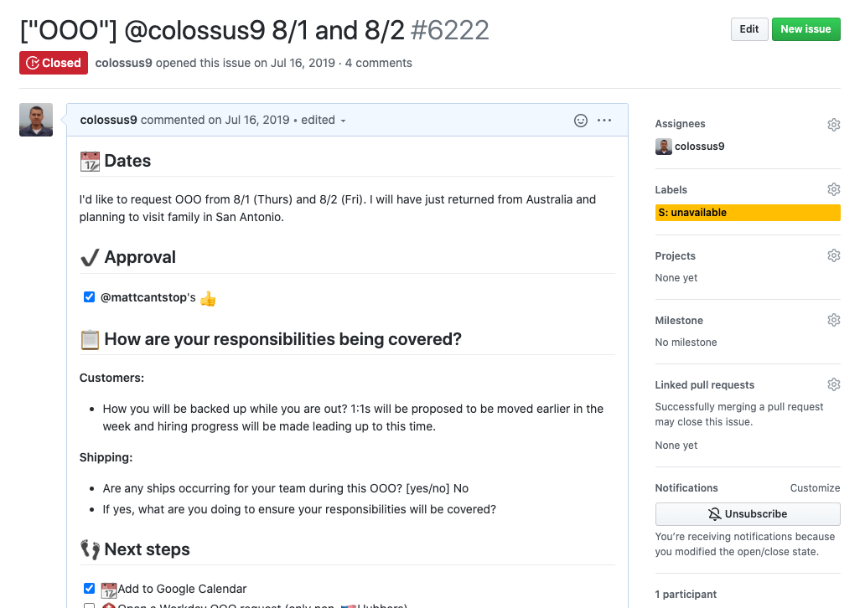
An out of office request using an issue
Notes:
The screen shows an out of office request that was generated using a template.
The title is tagged with the out of office flag. The user name is included as well the dates being requested.
In the body, you can see that important, relevant sections have been formatted with headers that are easy to read.

Slide 59
How GitHub uses the boards
We also use project boards to track internal items. For example:
Coming soon, Coming next, Shipped
Feature requests, triage, requested by 11+ customers, etc.
Onboarding, week 1, week 2, feedback
Notes:
We also use project boards to track internal items.
Coming soon, Coming next, Shipped
Feature requests, triage, requested by 11+ customers, etc
Onboarding, week 1, week 2, feedback
Our feature-related communication at GitHub lands in projects boards to inform audiences about our roadmap. We also use the boards for onboarding. Managers track the progress that new hires are making on a predefined set of tasks used get those new hires up to speed.

Slide 60
Experiment without risk​
Branch:
Question, hypothesis, experiment, analyse, conclude​ ​
Pull Request:
Compare two branches. Gather feedback from peers and integrate with 3rd party products to perform automation for quality of code, build status, and deployment​.
Notes:
The GitHub platform gives us a place to experiment without the risk of interfering with finished work. Use branches and pull requests to accomplish this.
GitHub uses branches to:
Question
Hypothesis
Experiment
Analyze
Reach conclusions
Once work has been done on those hypothesis or experiments, Hubbers gather feedback from peers and integrate with 3rd party products for automation, quality of code, build status, and deployment.
If someone gets notified to do a code review in the repo, first look at the statuses such as build status to see if all of those have passed.

Slide 61
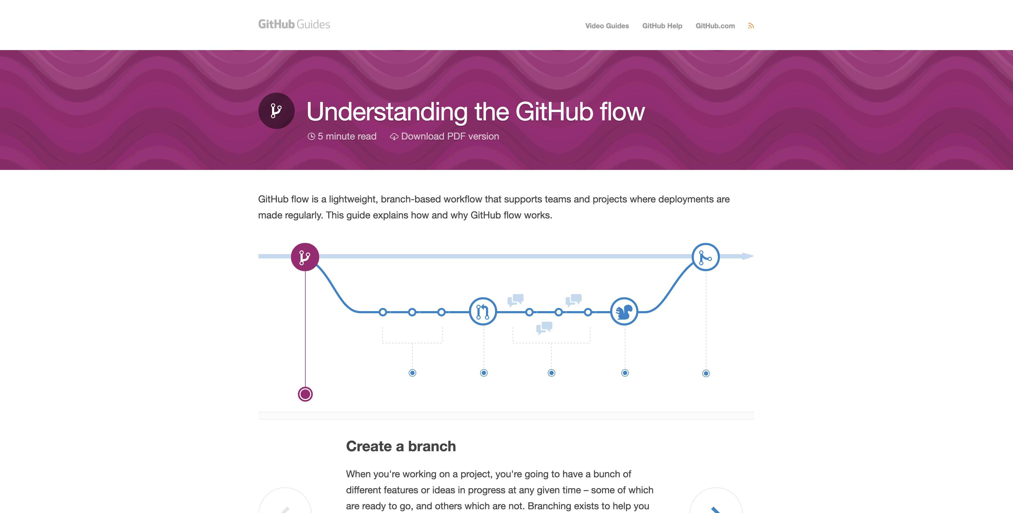
https://guides.github.com/introduction/flow
A GitHub flow guide
Notes:
We typically recommend, by default, the GitHub flow.
Note to speaker: Learn more about the GitHub flow in the GitHub Guides. https://guides.github.com/introduction/flow
In the GitHub flow, you have one branch, and you create a branch based on your idea or experiment and then merge back into main.

Slide 62
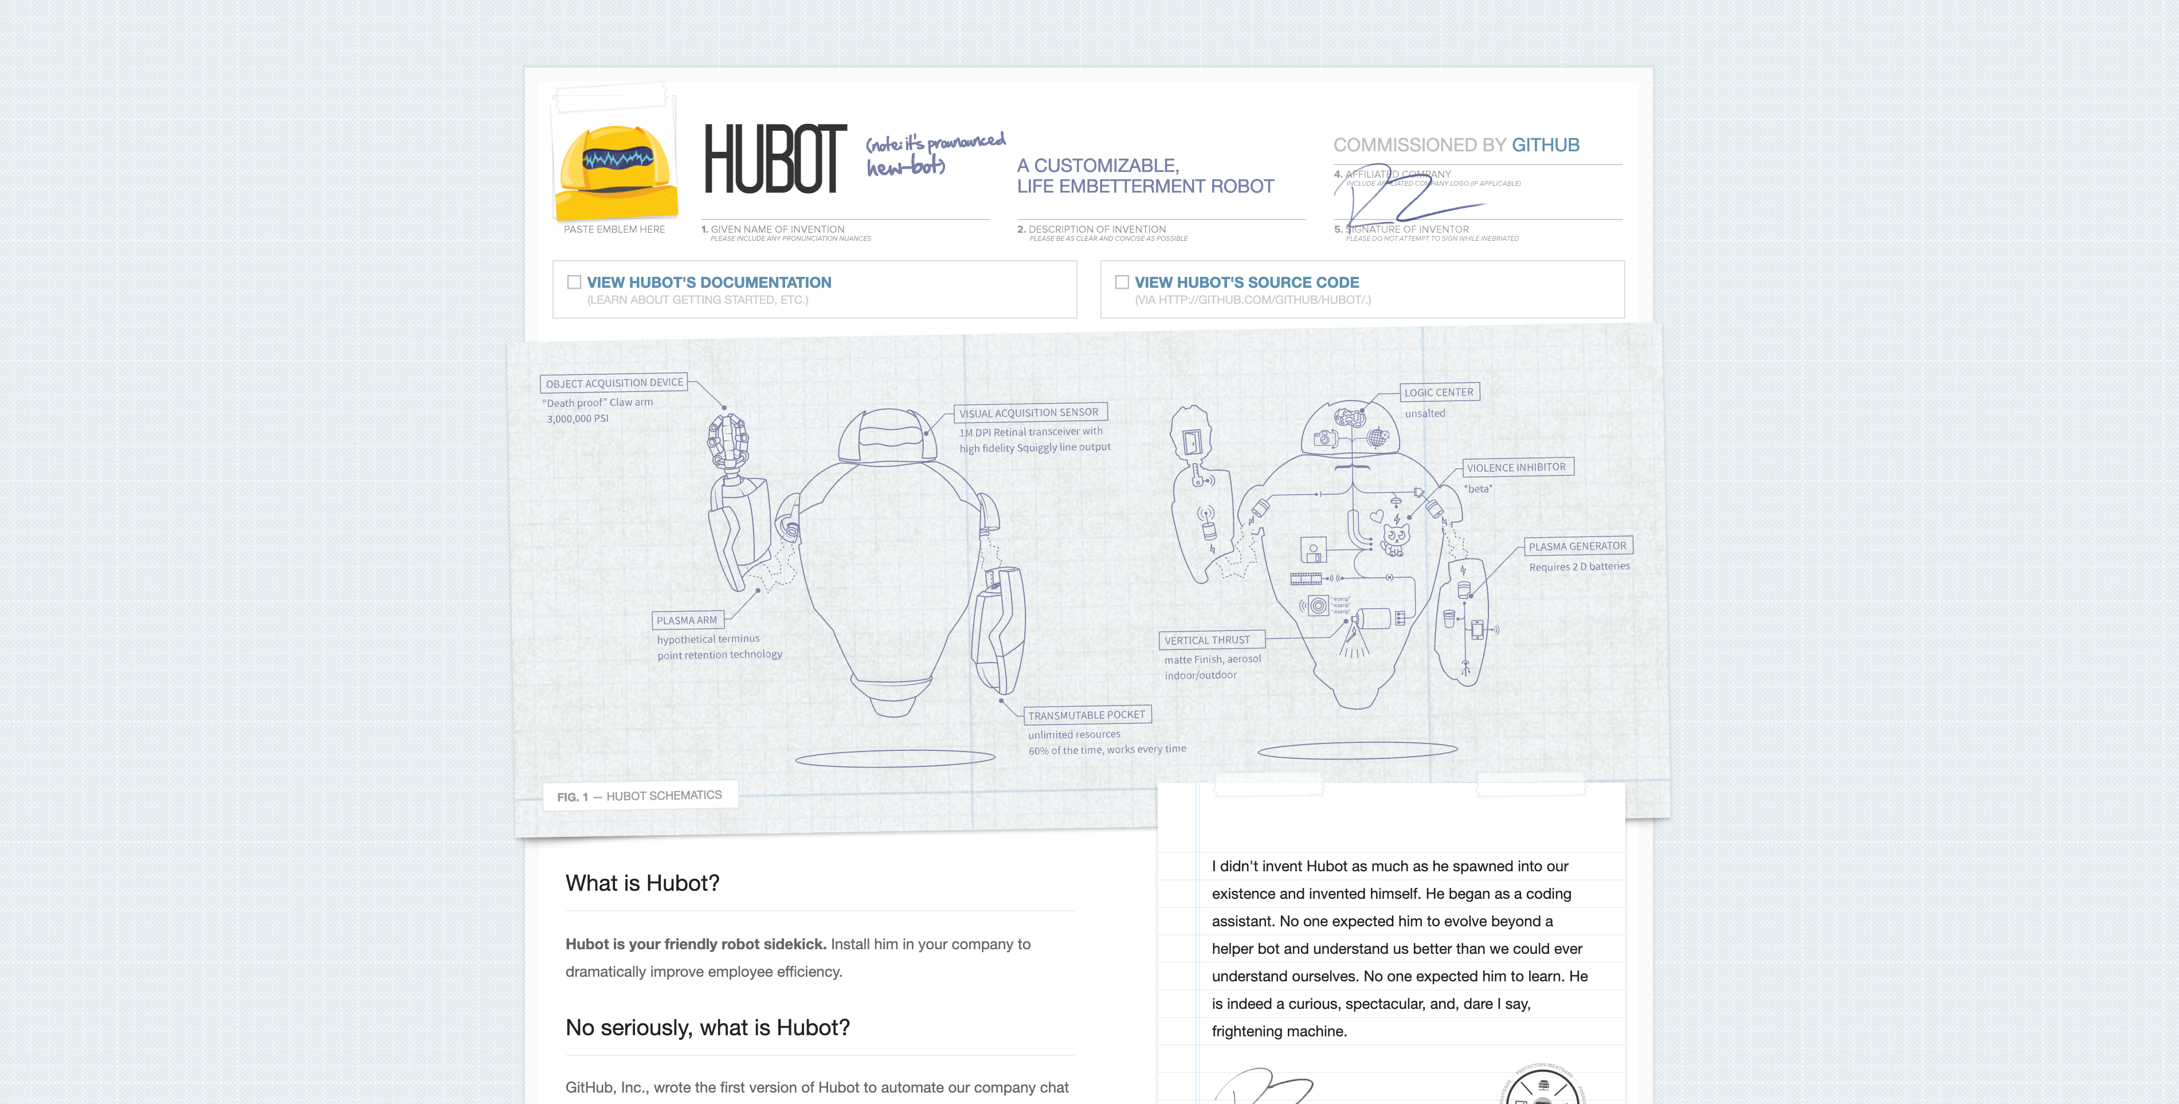
https://hubot.github.com
The Hubot landing page
Notes:
GitHub uses Hubot inside of Slack to collect data out of GitHub itself.
GitHub is full of data sources such as its API and databases. So, you can also use this functionality on any source that has programmatic access.
Reference: https://hubot.github.com

Slide 63
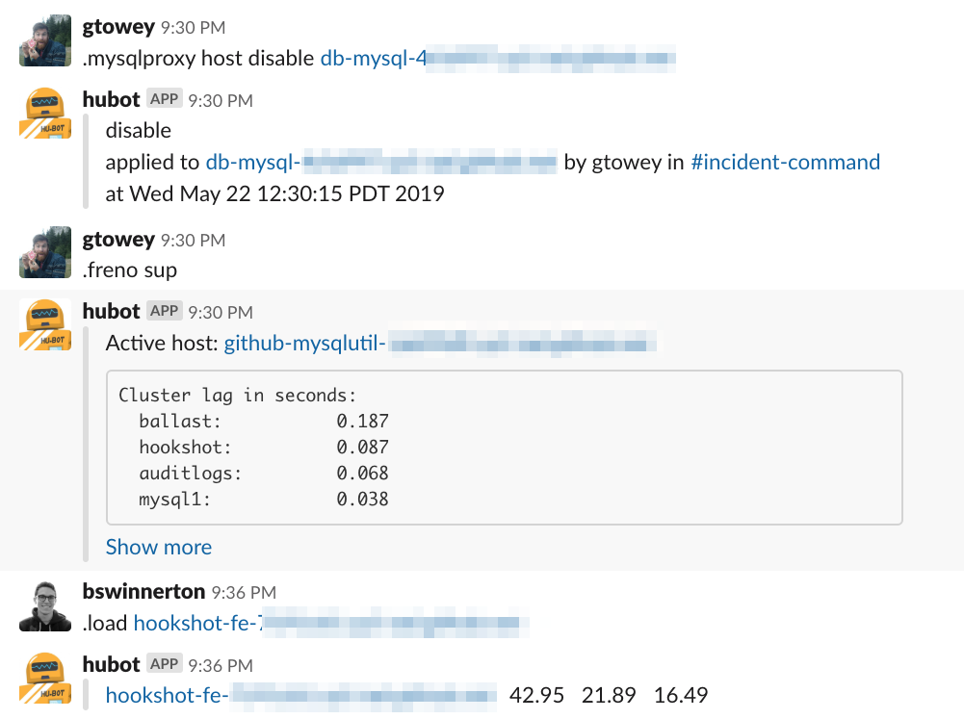
Hubot commands
Notes:
"Hubot does it all, from pulling up a graph of how many times we've deployed this week, hows our loadbalancer doing for GitHub.com, enabling maintenance on our infrastructure, to finding out who owns a service that may be down so you can get remediation on it as soon as possible by paging them"
Watching people type these commands help inclusivity and learning across the entire company.

Slide 64
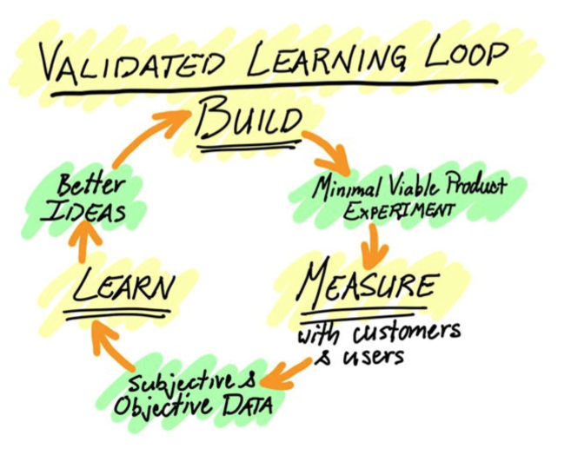
Notes:
Basically, this validated learning loop is the one we follow to go from the MVP or minimal viable product to the final build.
Remember,
you are never done with your journey
“In three years, this presentation will be completely different”

Slide 65
UI walkthrough

